Slide 1

Smart Cooler Installation
Android Installation Guide
October 2024
© 2024 Vision Group

Slide 2

APPLICATION FEATURES
ASSOCIATION – To Associate the Smart Device and Remove the association with the Cooler.
DEVICE SCANNING AND CONFIGURE – To check Device Advertisement and Configure.
DFU – Direct Firmware Update of Smart Devices.
DATA DOWNLOAD AND UPLOAD – To Download and Upload data of the Smart Devices
FIX FAULTY DEVICES – To Fix the Faulty Devices.
TEST AND VERIFY – To verify the Faulty Device after the Fix.
© 2024 Vision Group

Slide 3
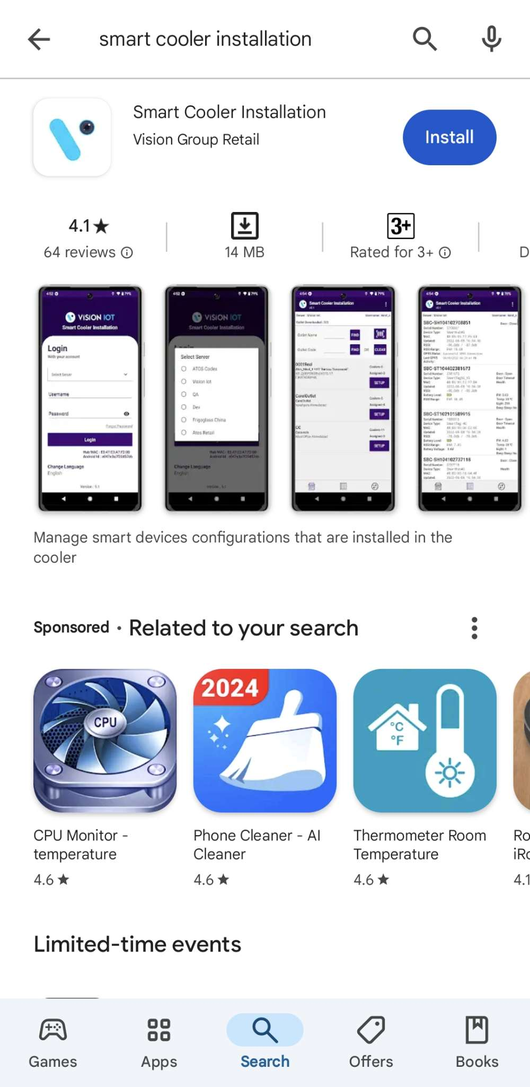
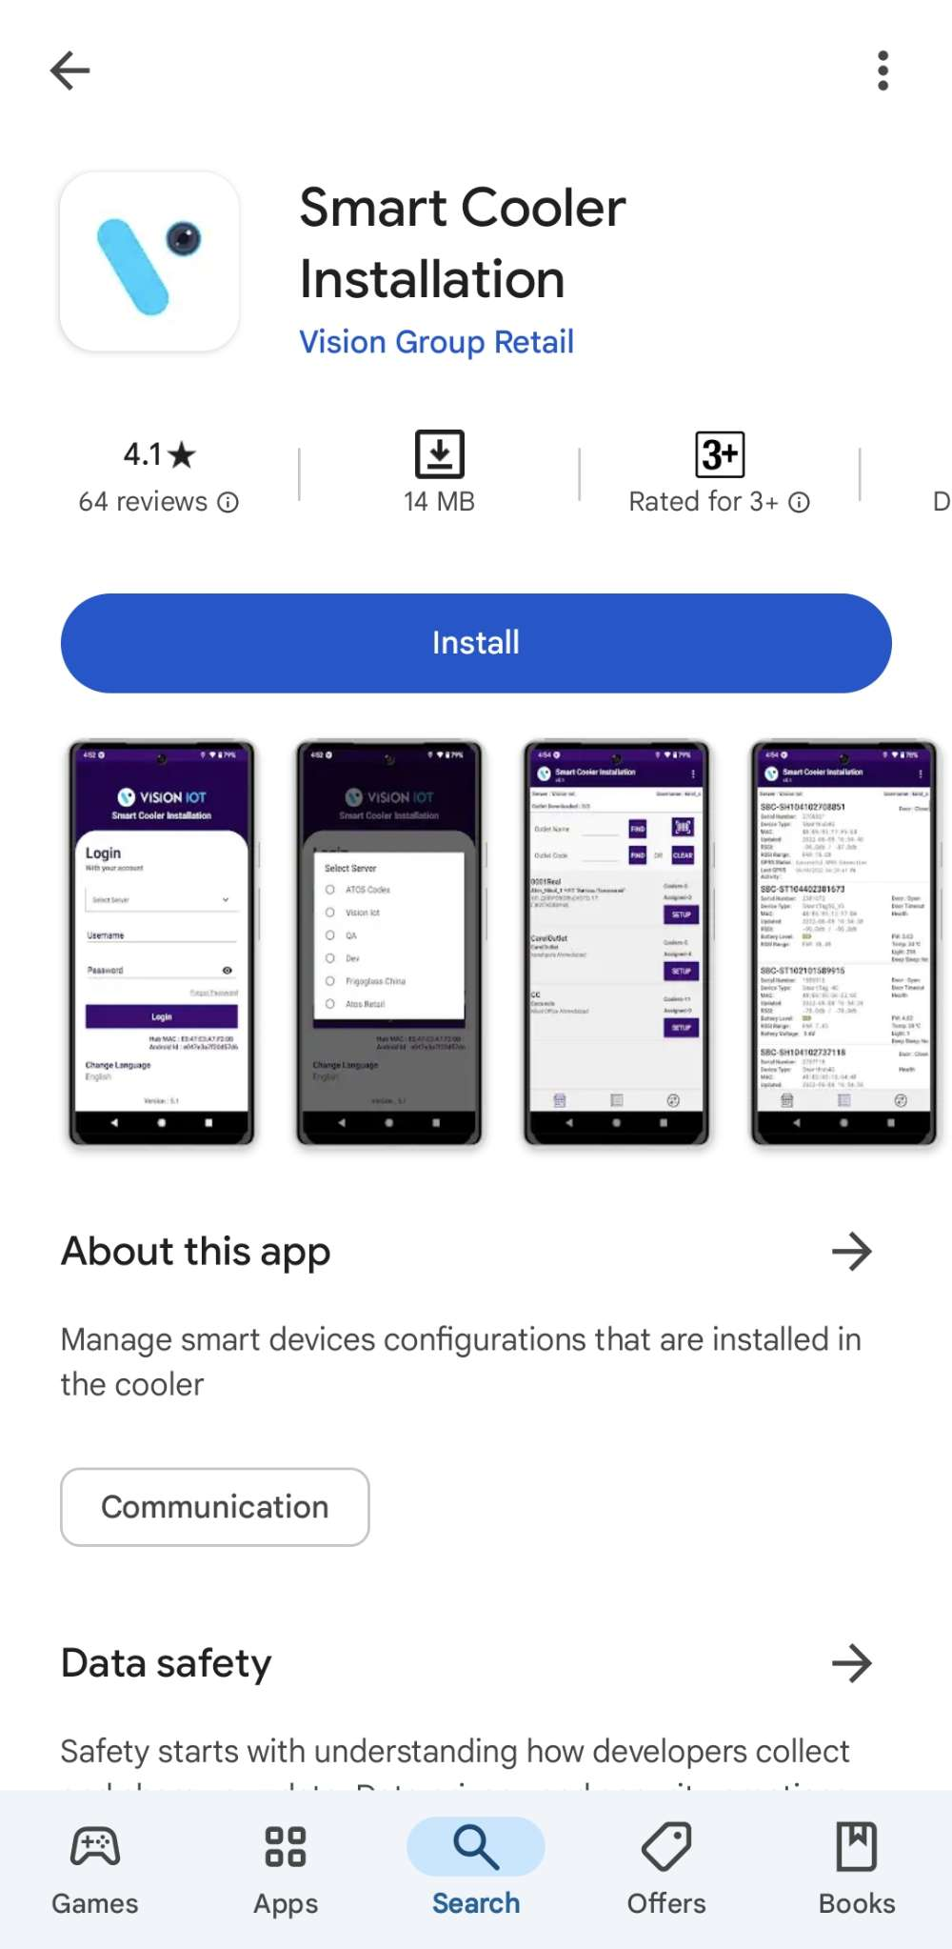
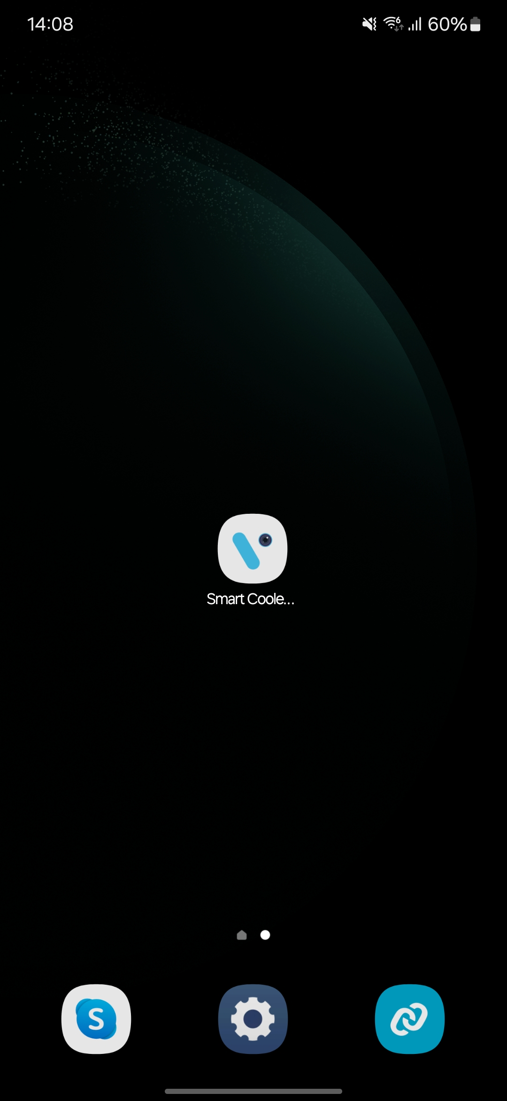
APPLICATION INSTALLATION
Please remember the following instructions: Open the Play Store on an Android device. Search for the “SMART COOLER INSTALLATION" application and install it.
Remember to delete the previous version of the application before installing a new version.
© 2024 Vision Group

Slide 4
APPLICATION PERMISSION
After initial Installation & launch, the Application will ask for permission to access. Camera Permission, File and Media Permission, Location Permission, Nearby Device Permission Need to Allow.
Choose Server: The server should be ATOS Codex for CCH, and another server should be chosen for other customers and QA.
LOCATION PERMISSION
For Location (so beacons can be found) - Choose Allow While Using for Android OS 9 and Above.
Then Go to the Settings > Application List > Location > Allow Location Access option is “Always”.
NOTIFICATION PERMISSION
Send notifications (to inform of data download) -> Choose “Allow”
BLUETOOTH PERMISSION
Access the Bluetooth (to scan barcodes) – the first prompt on the Outlet screen -> Choose “OK”.
© 2024 Vision Group

Slide 5
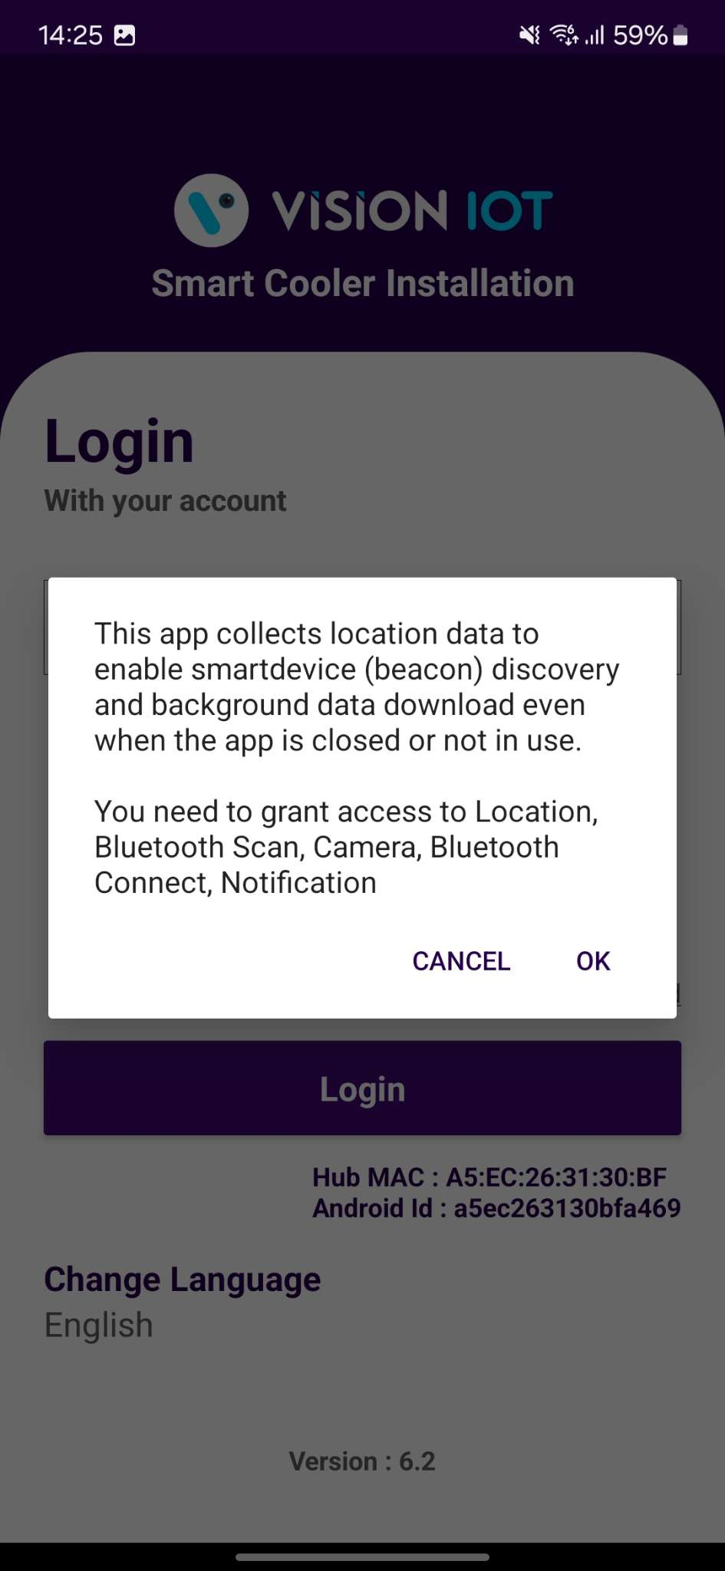
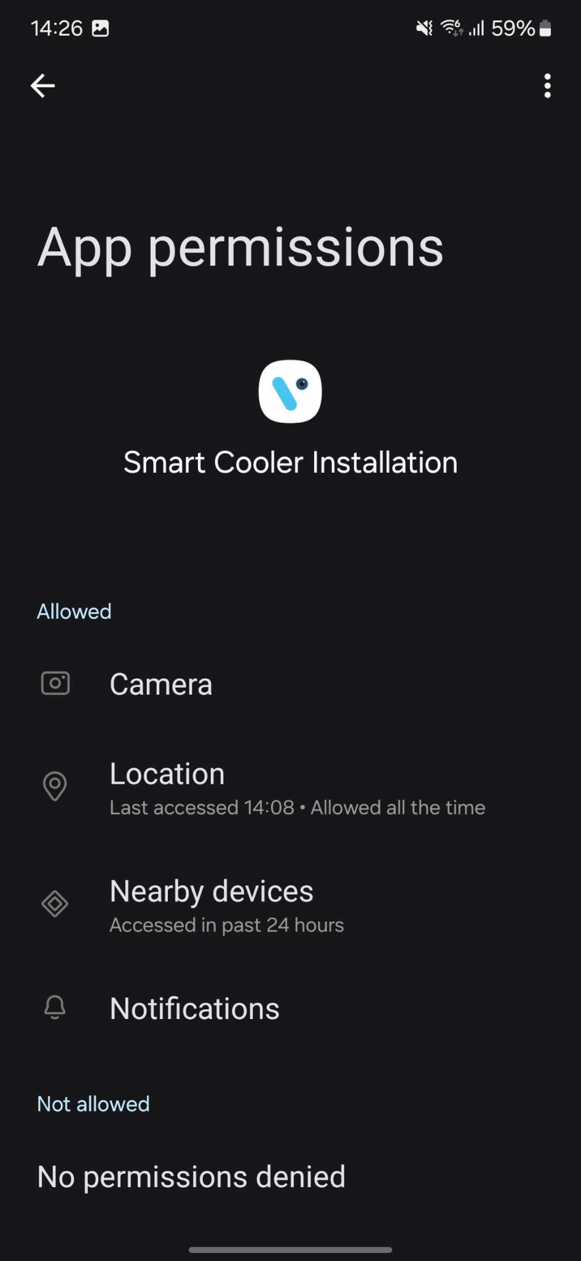
LOGIN
After successfully installing the Smart Cooler Installation Application, open it, and it will redirect you to the Login Page. Select the server from the server list and Login in the application using the credentials provided by your administrator after successful login.
Remember to ensure Bluetooth & Mobile Wi-Fi or Mobile Data are ON in the device.
Bluetooth also should be enabled as well as location services.
The application requires an internet connection for initial login.
After the initial log in the application can work in Offline mode provided that the same username & password as the one in the online login is used.
Minimum device requirements – Device Has RAM 4 GB and above and Bluetooth Version 4.2 and above.
The Minimum OS version of mobile is OS 10 and Above.
The Change from v. 5.1 is that All data (outlets, assets, remote commands, firmware) is downloaded After showing the Outlet Screen.
© 2024 Vision Group

Slide 6
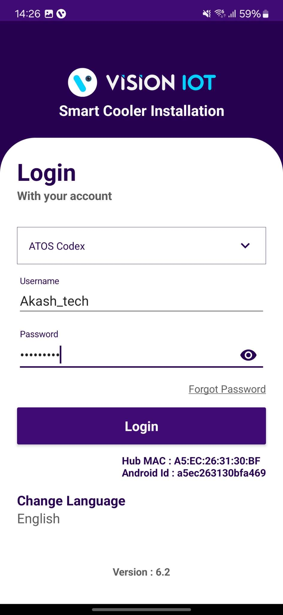
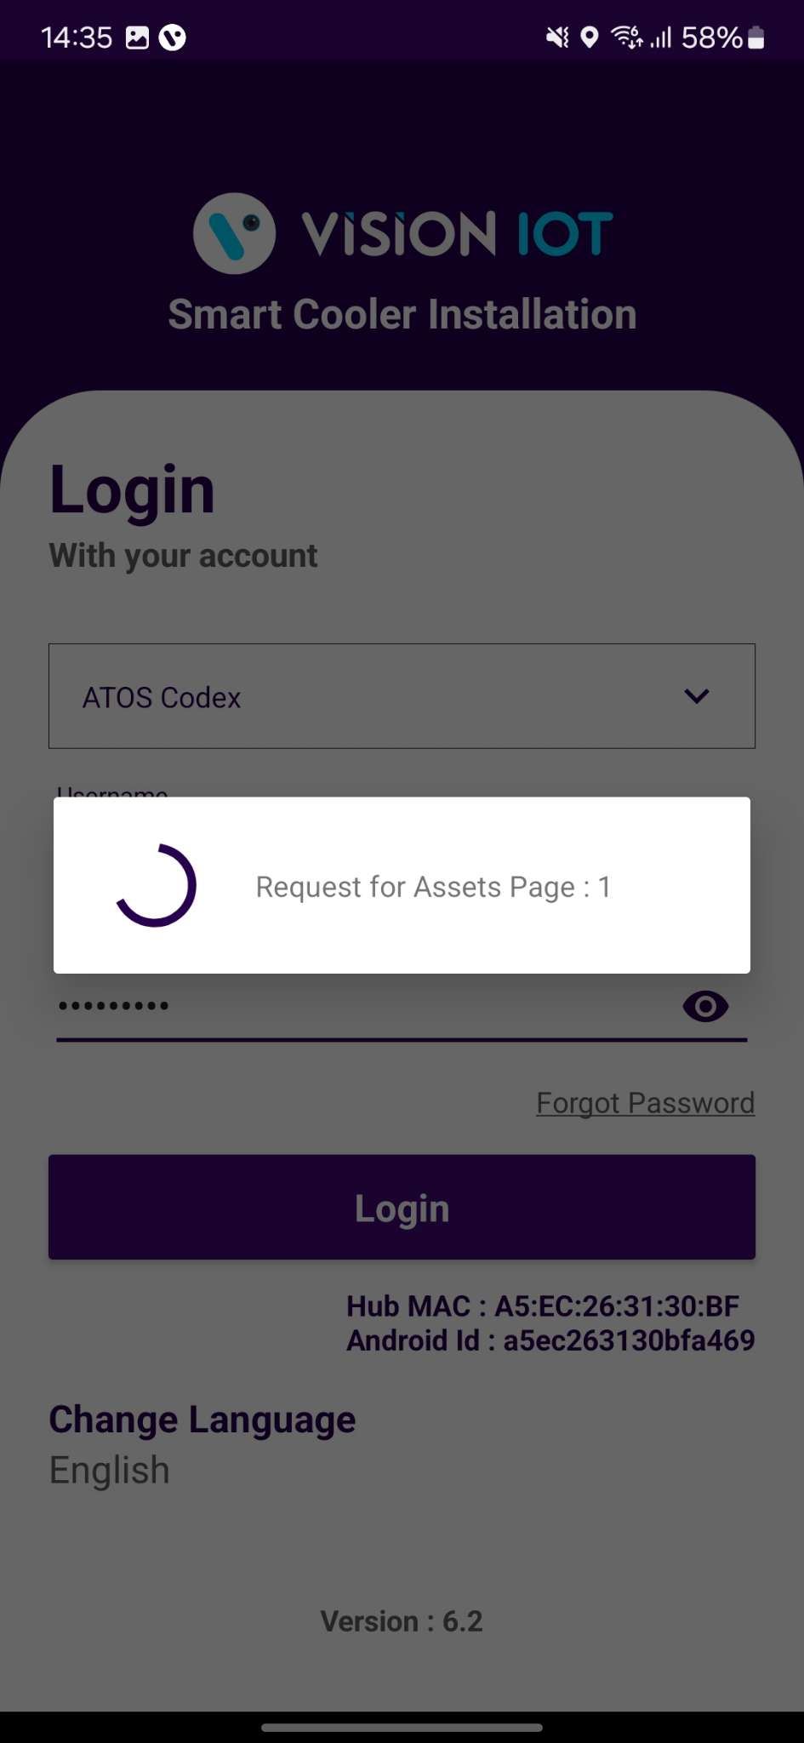
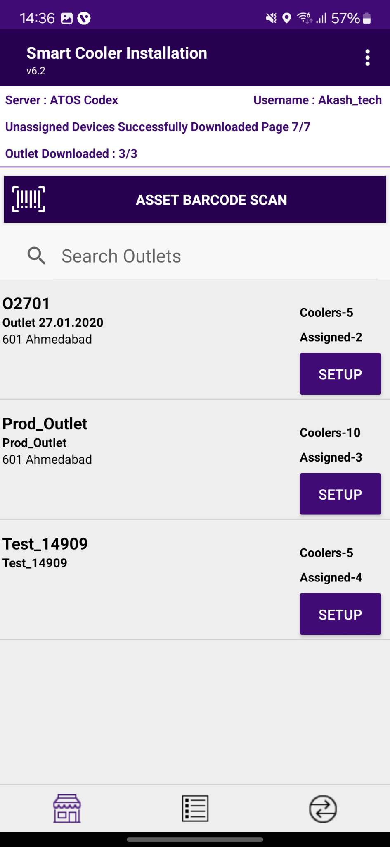
LOGIN (CONT’D)
Provide valid credentials and tap on the Login button, please be advised that the application will need some time to download data from the cloud.
Note
Internet connectivity is required during login otherwise login will fail, and the application will show network errors.
© 2024 Vision Group

Slide 7
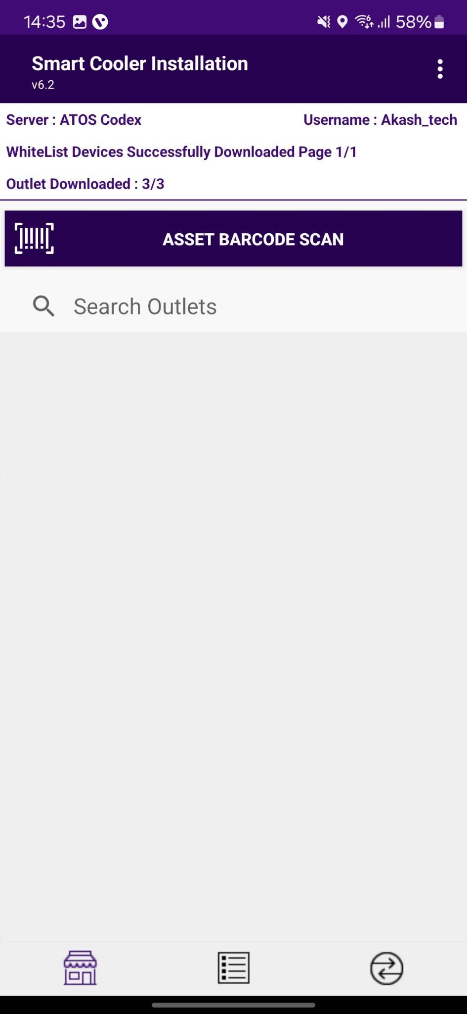
APPLICATION FUNCTIONS
1. Association Screen - Use for the Association and Remove Association.
2. Configuration Screen - Use to Check the Device Advertisement and Configuration it.
3. VH Screen - Use for the Data Download and Upload to the Server.
1
2
3
© 2024 Vision Group

Slide 8

ASSOCIATION SCREEN
Click on the Association Icon to move to the Association Screen.
Total # of outlets in BD territory and how many have been loaded, outlets are loaded at startup.
Use this box to quickly search for the Asset Serial. If a cooler is found the association menu for this cooler will be shown.
Use this box to quickly search for the Outlet Code or Outlet Name. If an Outlet is found the result of the Outlet will be shown.
On successful login, a list of outlets will be shown.
Only Assigned User outlets will be shown, for each one the Outlet name, address & code will be displayed.
Coolers – 10
Shows the number of coolers in the outlet.
Associated – 3
Shows the number of coolers already associated/ provisioned.
Tap on Setup to enter the Outlet and view assigned and unassigned Coolers.
© 2024 Vision Group

Slide 9
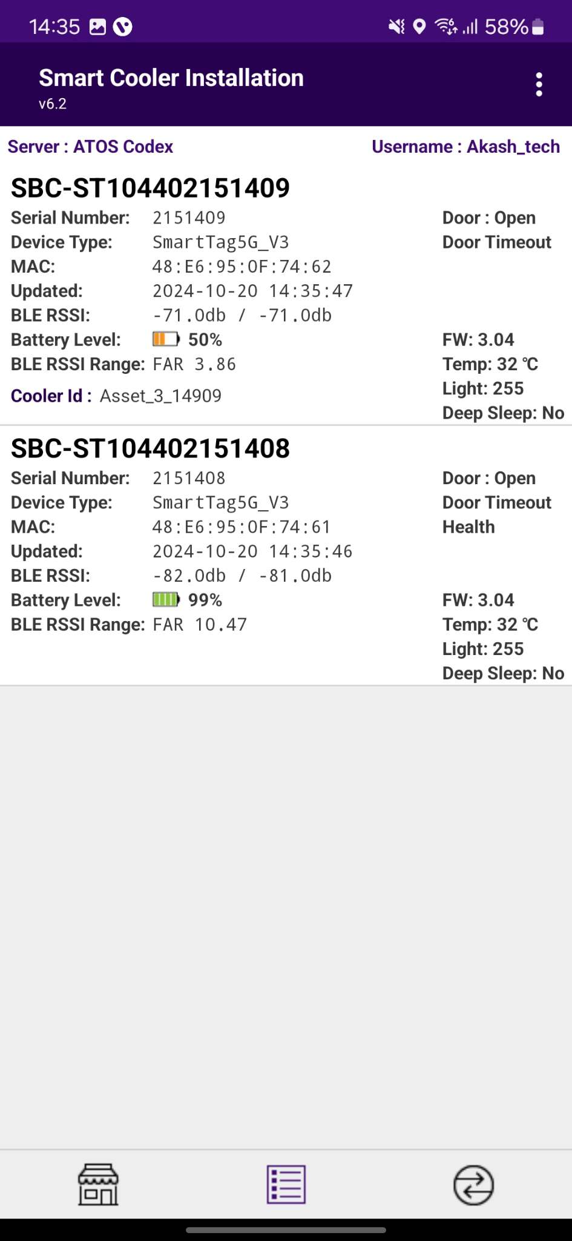
CONFIGURATION SCREEN
Click on the Configuration Icon to move to the Configuration Screen.
Smart Device # – Smart Device Serial Number
Smart Device Type – Type of Smart Device
MAC Address – Smart Device’s MAC Address
Updated – Last Update Time while Device found in Scan
RSSI – Range of Smart Devices in dB
Battery Level – Smart Device Battery Level(Green > Orange > Yellow > Red)
RSSI Range – Range of Smart Devices in meters
iBeacon Frame – Smart Devices iBeacon Advertisement Frame(Showing if Enable)
Major – Smart Device iBeacon Major value
Minor – Smart Device iBeacon Minor value
TX – Smart Device Transmit Power value
Distance – Range of Smart Devices in meters
UUID – Smart Devices iBeacon UUID Value
Standby – Flag Showing if Device in Standby Mode
Door – Flag of Door Status is Open /Close
Health – Flag of Health if available for Smart devices
Pic – Flag of Image if available for Smart devices
FW – Firmware Version of Smart device
Temp – Current temperature Value of Cooler
Light – The light Status of the Cooler
Deep Sleep – Flag Showing if Device in Deepsleep Mode

Slide 10
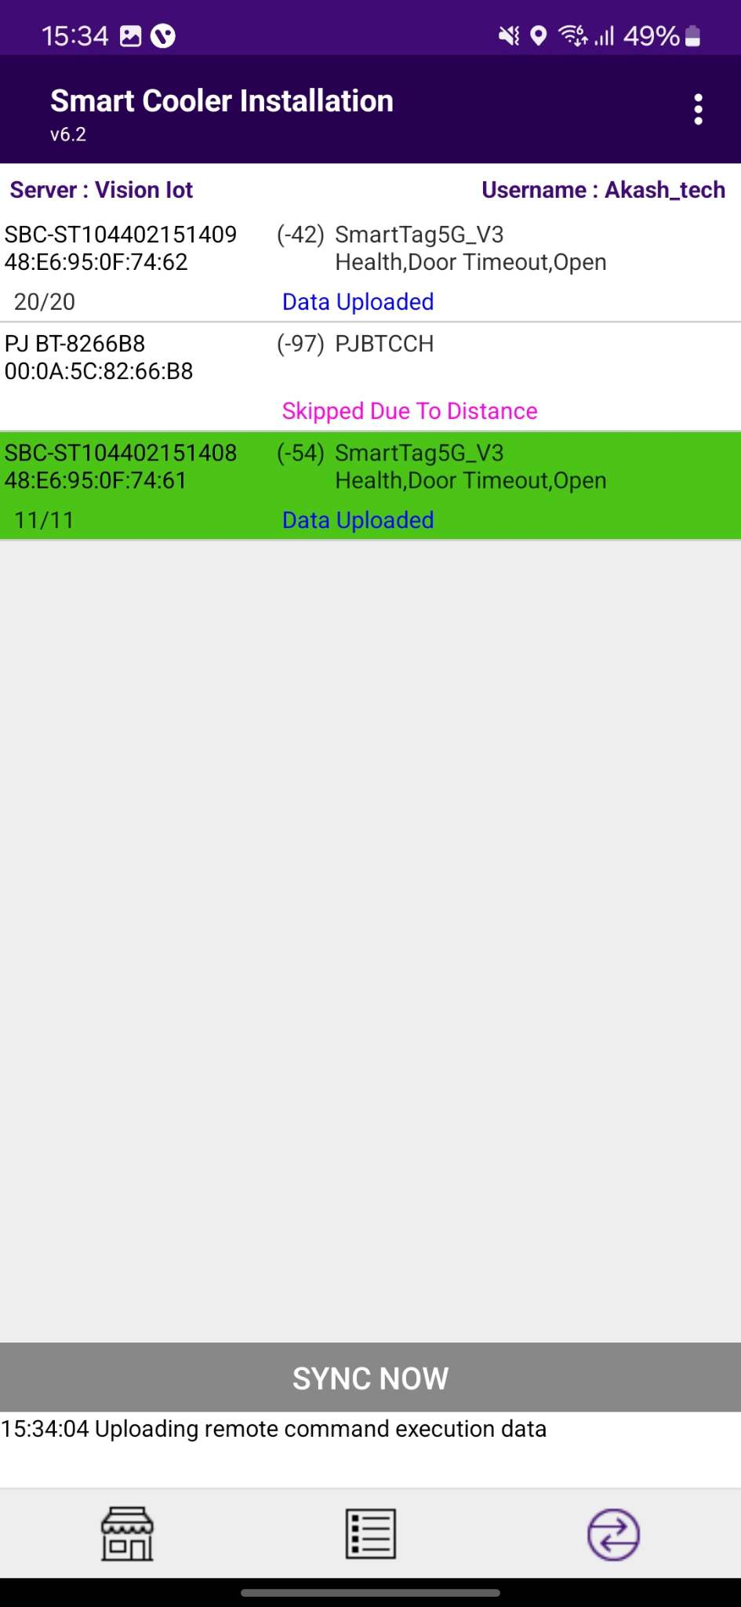
VH SCREEN
Click on VH Icon to move to VH Screen.
Showing the Nearest Whitelisted Devices here for which the Application Can download the Smart device’s Data and Upload it to the Server.
In each Smart Device Type, Sensor Data Flags, MAC Address, Smart Device Serial, etc. Information is showing.
The operation status of each Smart device is performed by Application-like Connection > Data Download > Data Upload Status showing.

Slide 11
ASSOCIATION PROCESS
Selecting Asset – Using Barcode Scanning:
Click on the Barcode icon, Barcode scanning window will open.
Scan the cooler barcode using the barcode scanner – Position the camera of the mobile device in such a way that the barcode of the Cooler (Technical ID) is in the box.
Outlet will automatically be selected, and a menu will be shown for choosing the device that will be installed.
B. Alternative – Selecting Outlet by entering Outlet Code or Name:
If Scanning of the Cooler serial is not possible enter either the Outlet Name or Outlet Code and Tap on “Find”.
C. Alternative – Selecting Outlet – Manual selection of cooler
If Scanning of the Cooler serial is not possible and the outlet code/name is not known, the User can manually select the outlet.
A
B
C
© 2024 Vision Group

Slide 12
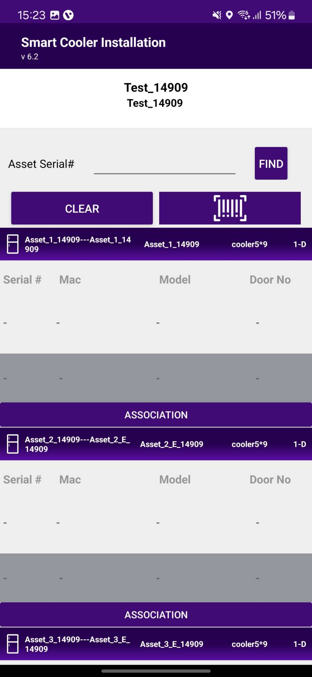
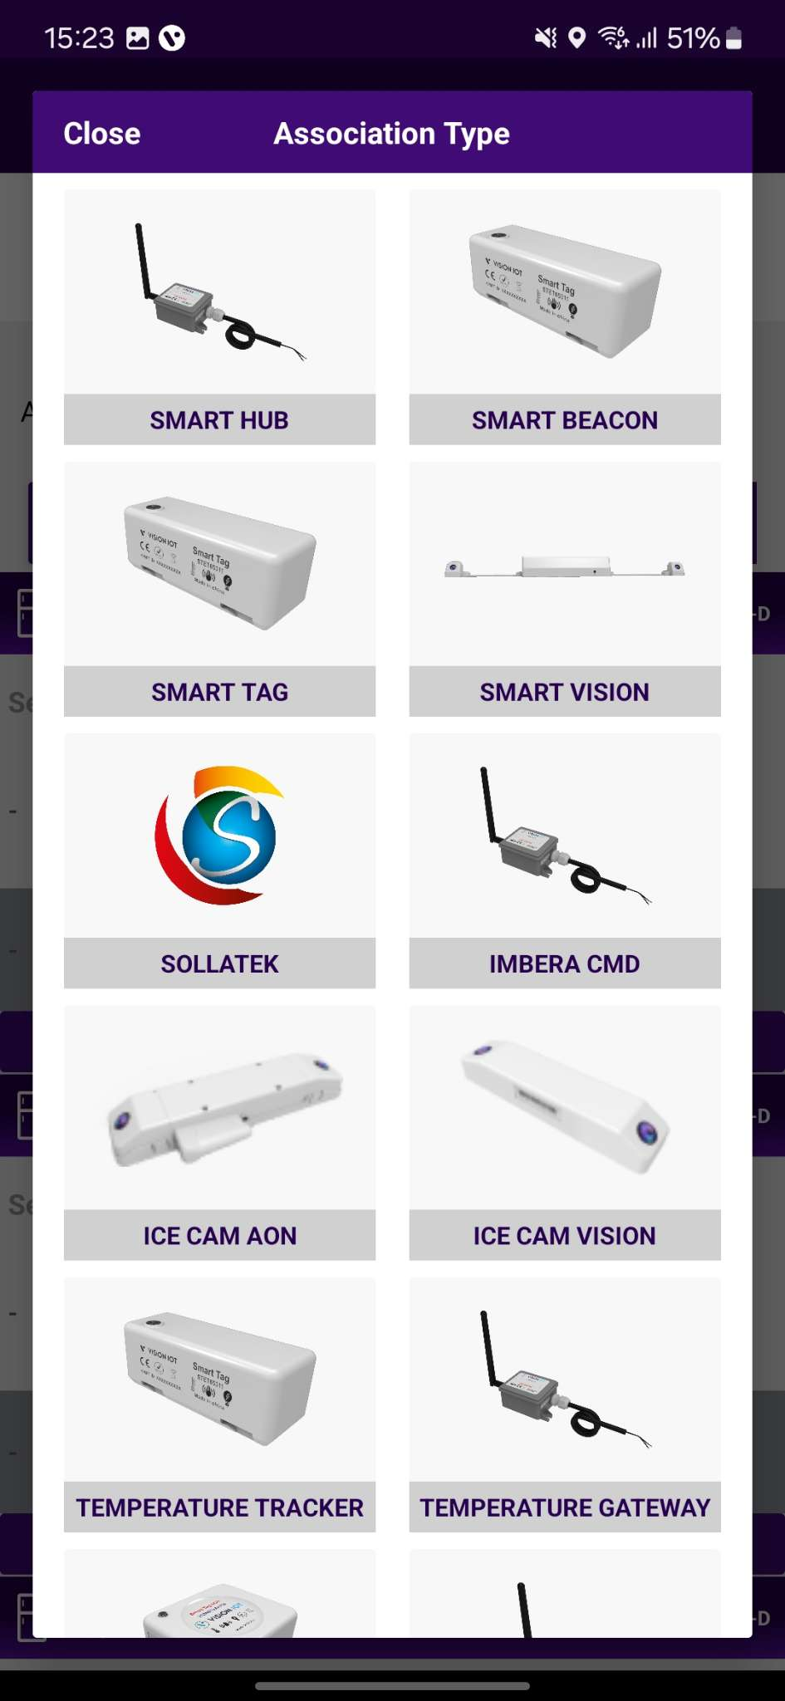
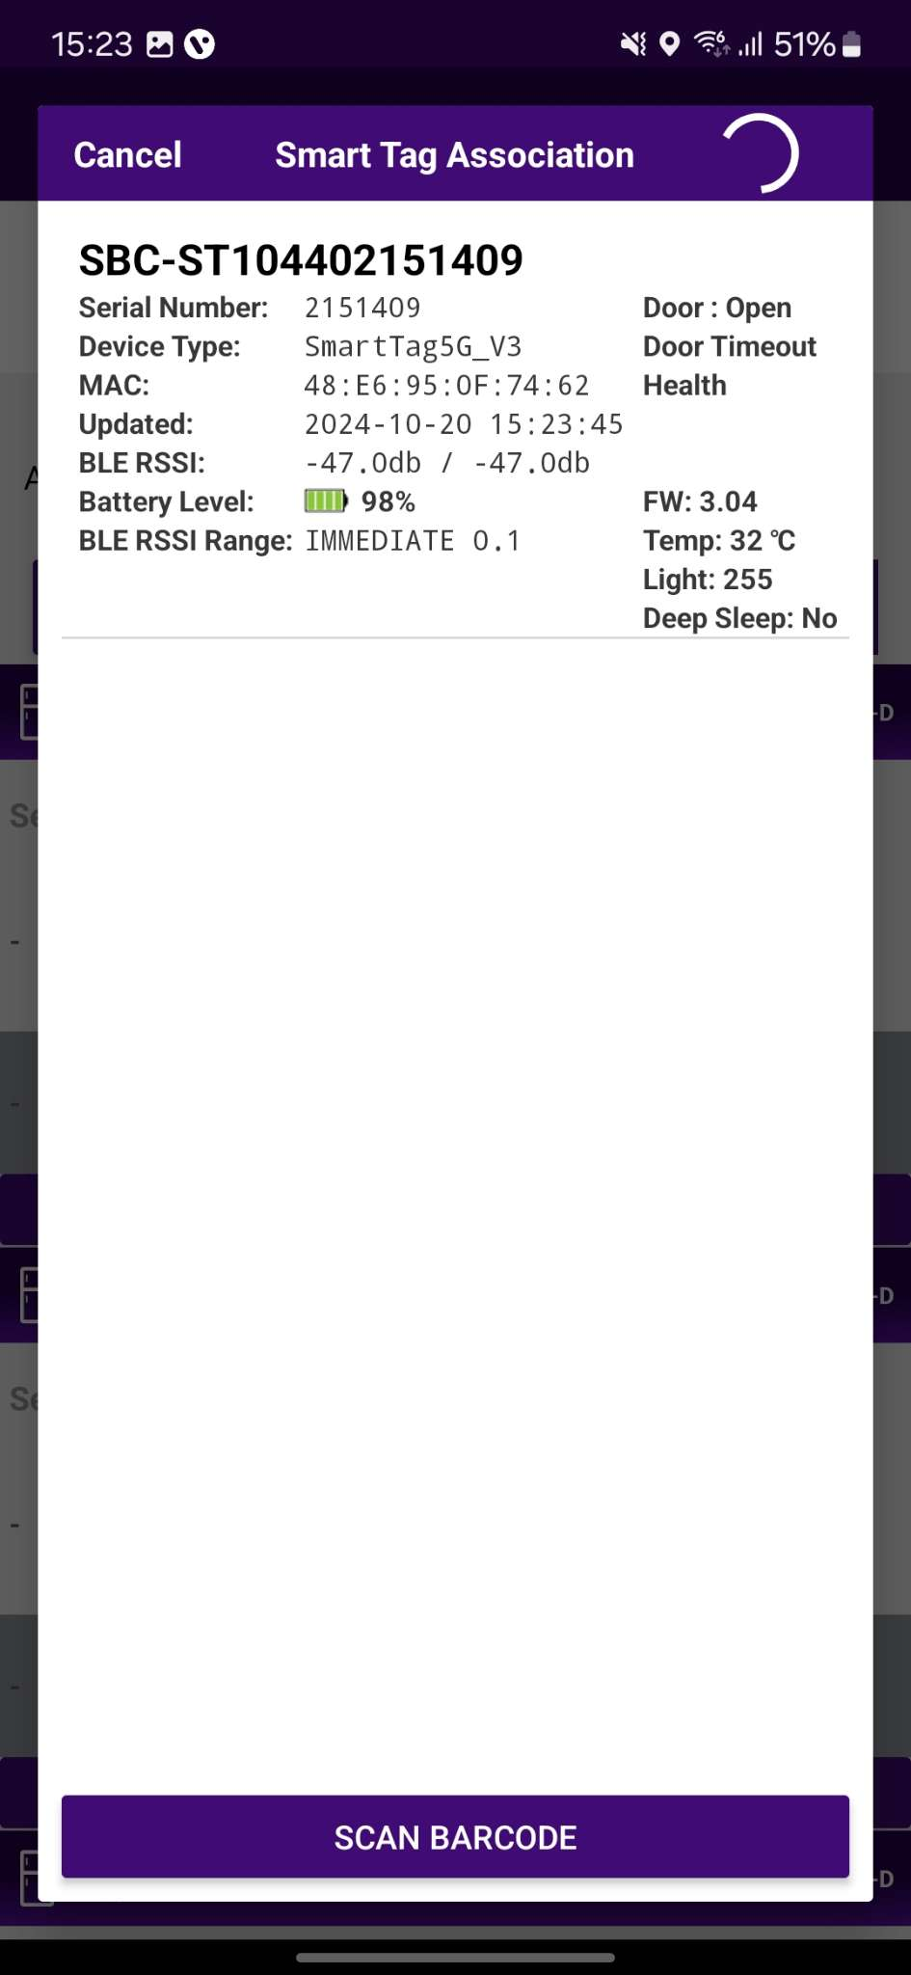
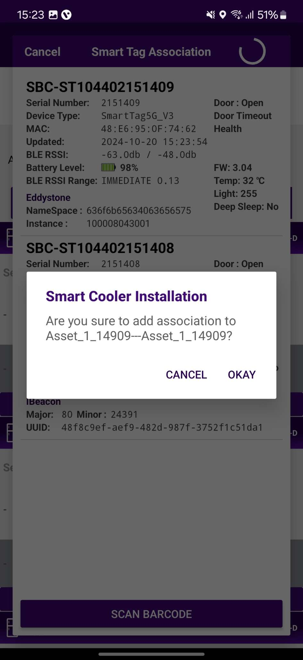
ASSOCIATION – SMART TAG
1. Selecting Cooler - A new window will open allowing the User to select the cooler for the outlet selected manually. Click on “Association” to choose the asset to install.
2. Selecting Smart Device type - A new window will open to ask for the selection of device types to be associated with. Click on “SMART TAG ” to Associate the SmartTag device.
The user will see a list of unassociated devices; the User can use the door status to identify the installed device.
© 2024 Vision Group

Slide 13
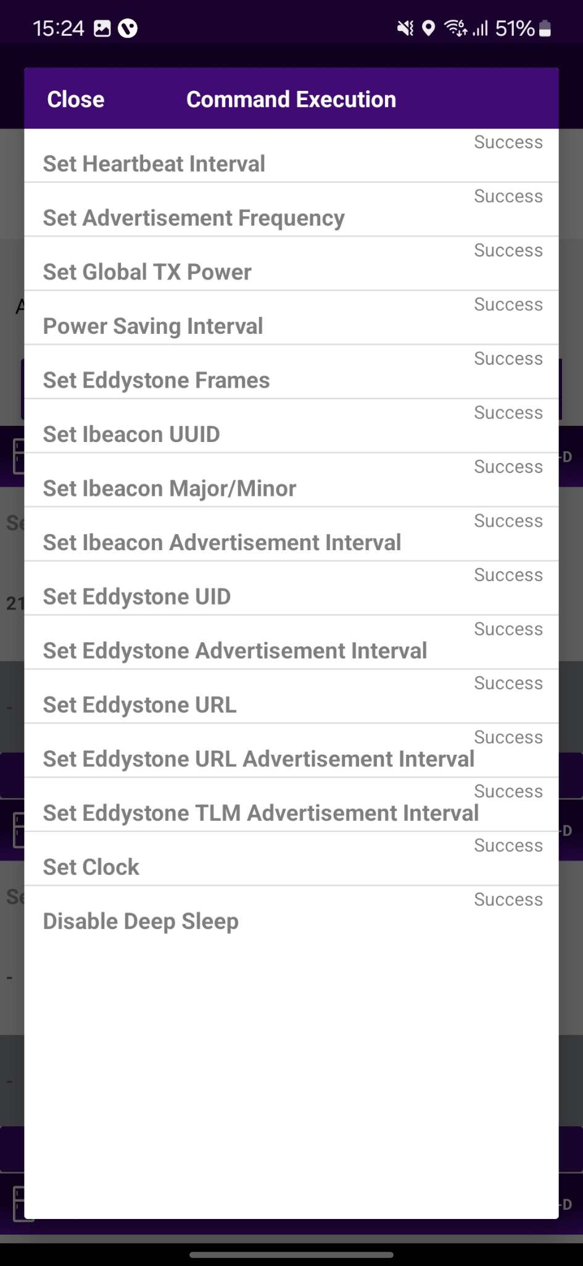
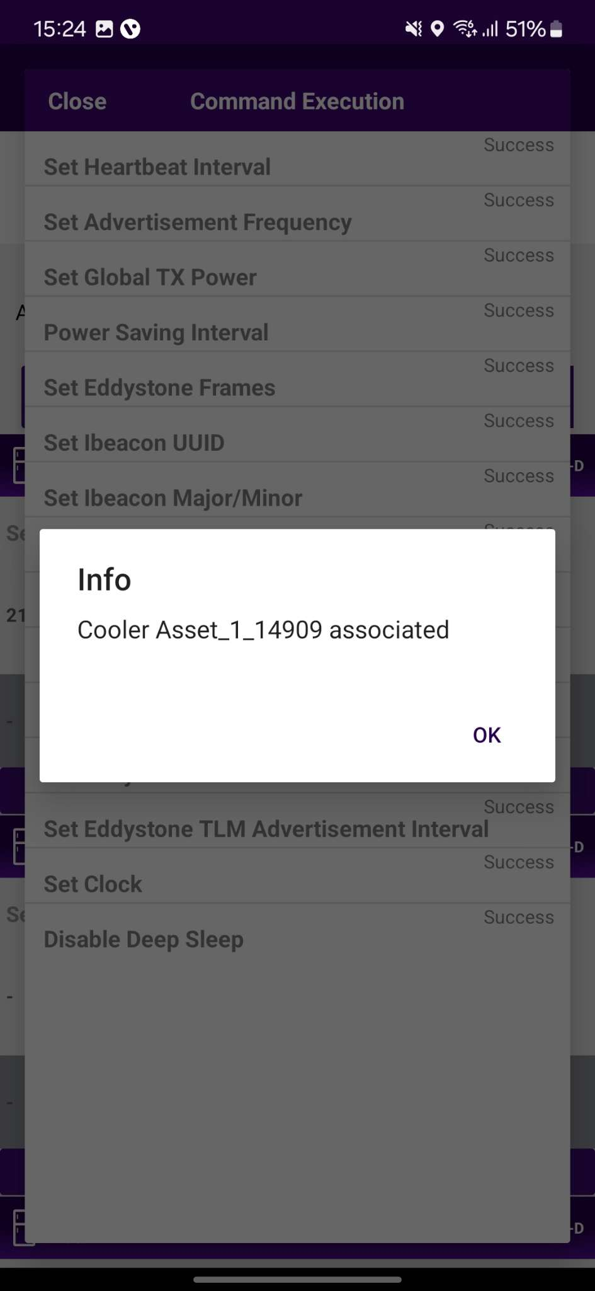
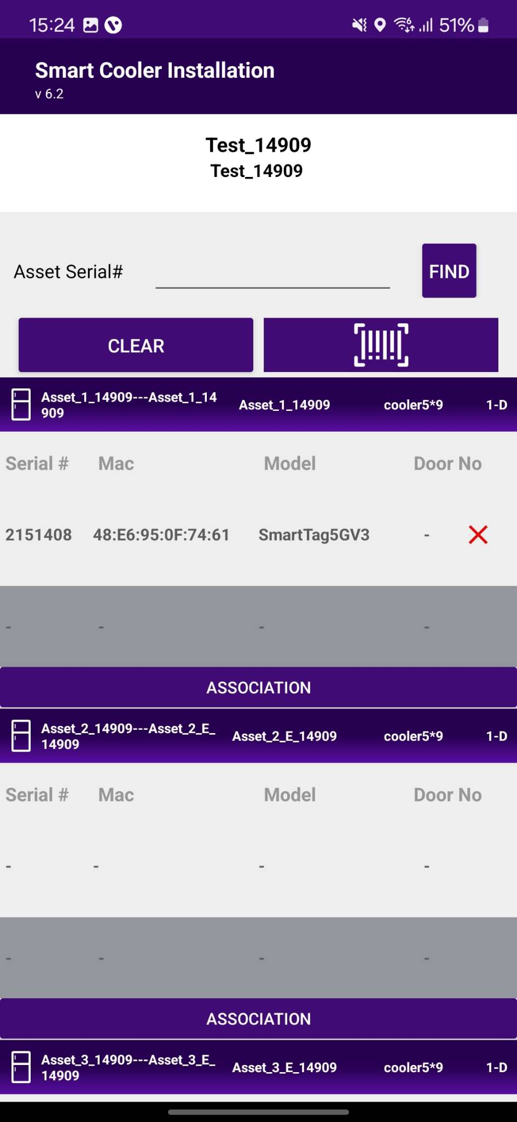
ASSOCIATION – SMART TAG
3. Selecting the Device to do the association with - After identifying the device, select the device to start Installation, App will give a popup to confirm the association, Click on OK to confirm. When the process is completed, the User will be returned to the Outlet Screen, and now the User see that the Proximity / Smart Tag is associated with the Cooler.
4. Smart Device Configuration Setting - On selection of the device, the application will connect to the device, make all configuration changes and provide status a success message will appear after successful association, press OK to close the popup. When this window appears the device is provisioned, and the User can press close to return to the outlet screen.
Note: Please note the device only wakes up when the cooler Door is Closed for 15 seconds.
© 2024 Vision Group

Slide 14
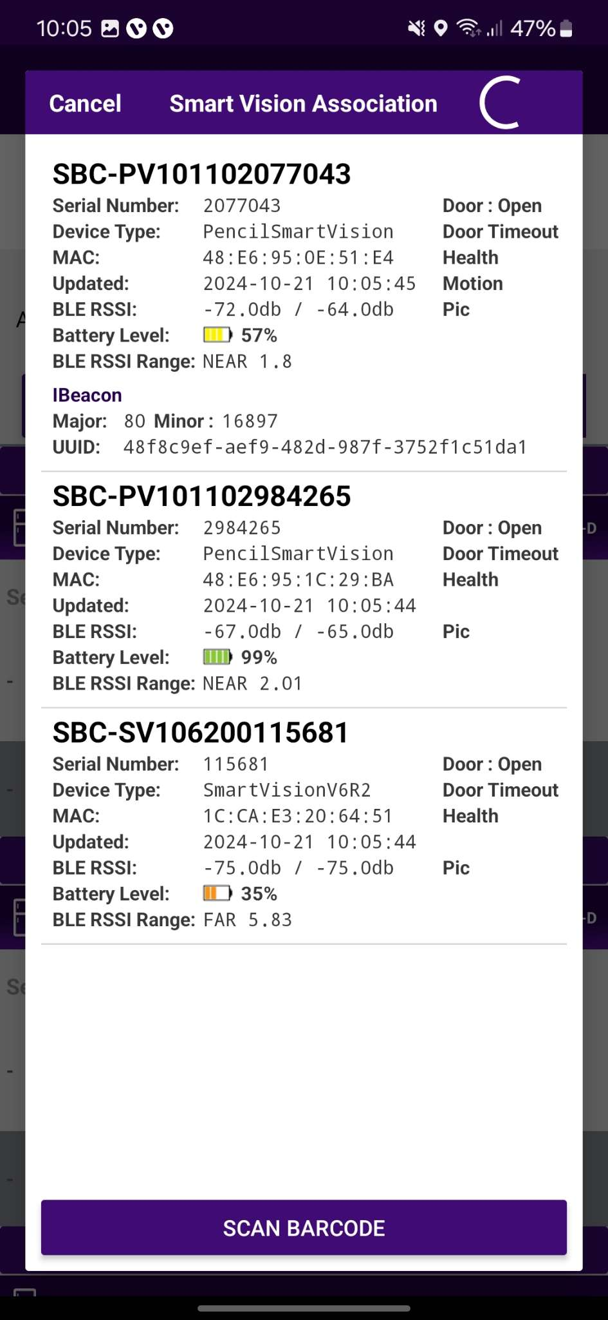
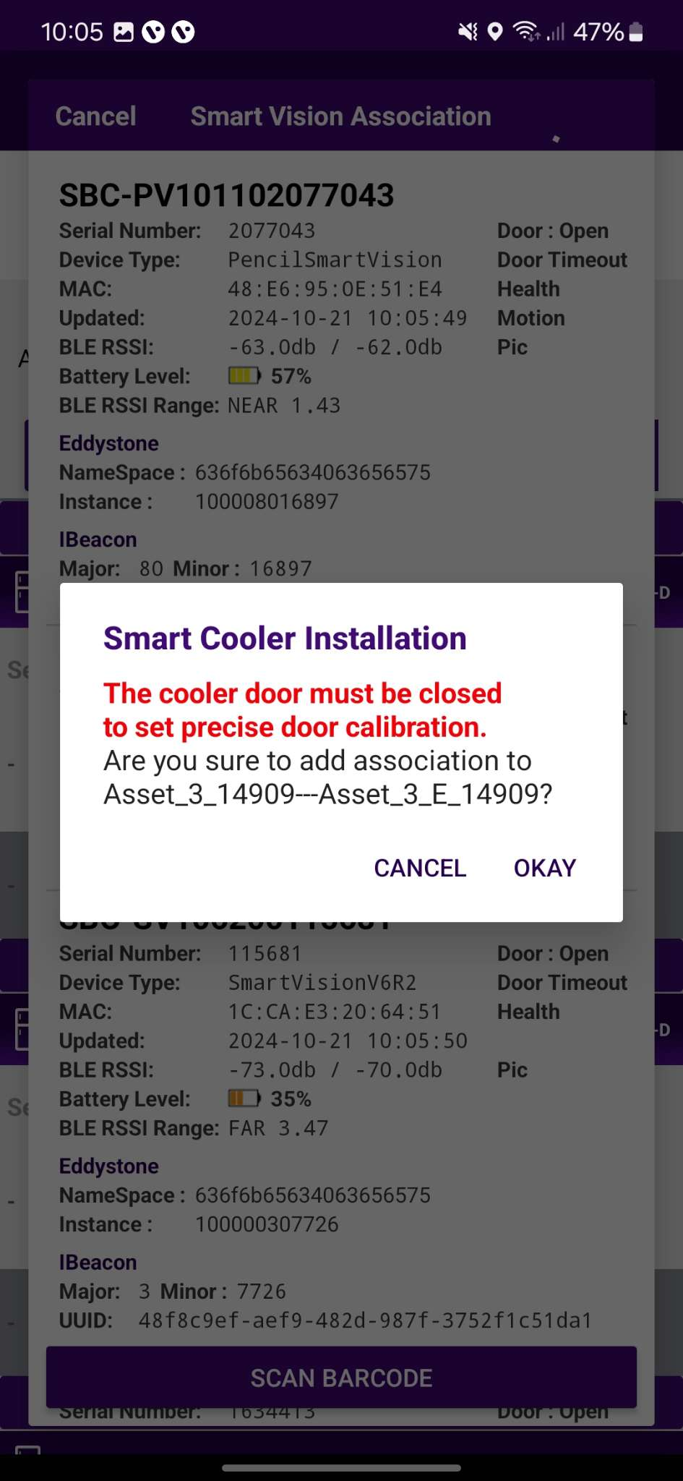
ASSOCIATION – SMART VISION
1. Selecting Cooler - A new window will open allowing the User to select the cooler for the outlet selected manually. Click on “Association” to choose the asset to install.
2. Selecting Smart Device type - A new window will open to ask for the selection of device types to be associated with. Click on “SMART VISION ” to Associate the SmartVision device.
The user will see a list of unassociated devices; the User can use the door status to identify the installed device.
© 2024 Vision Group

Slide 15
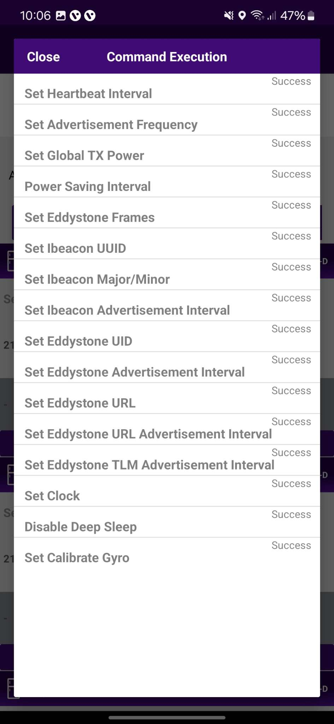
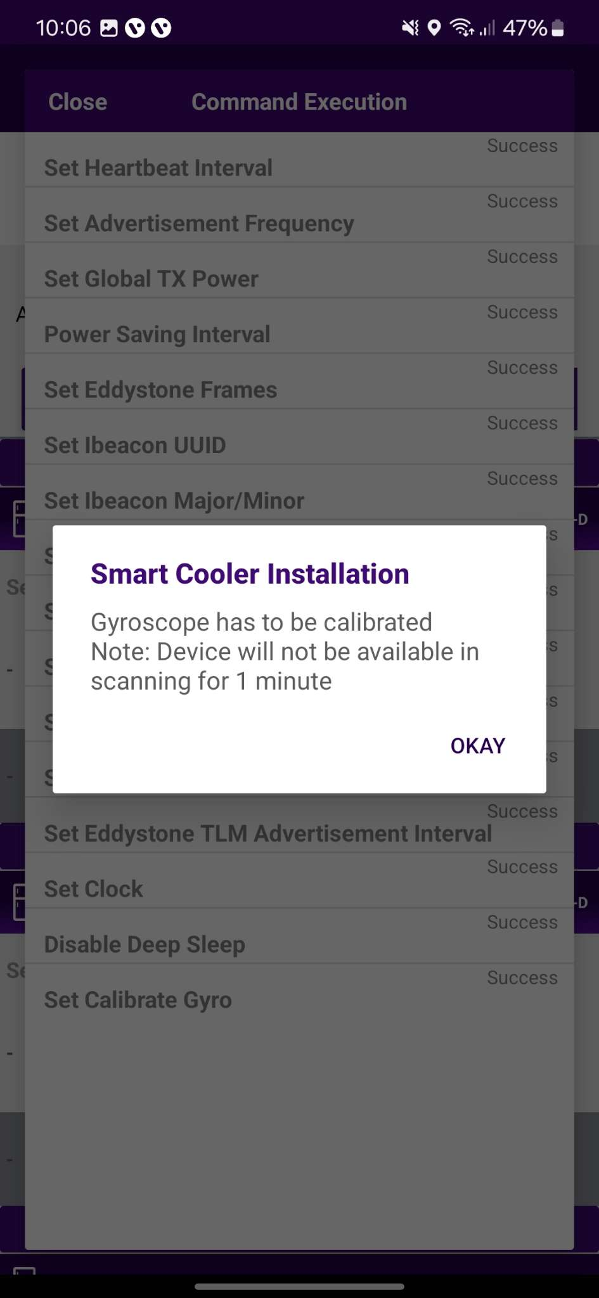
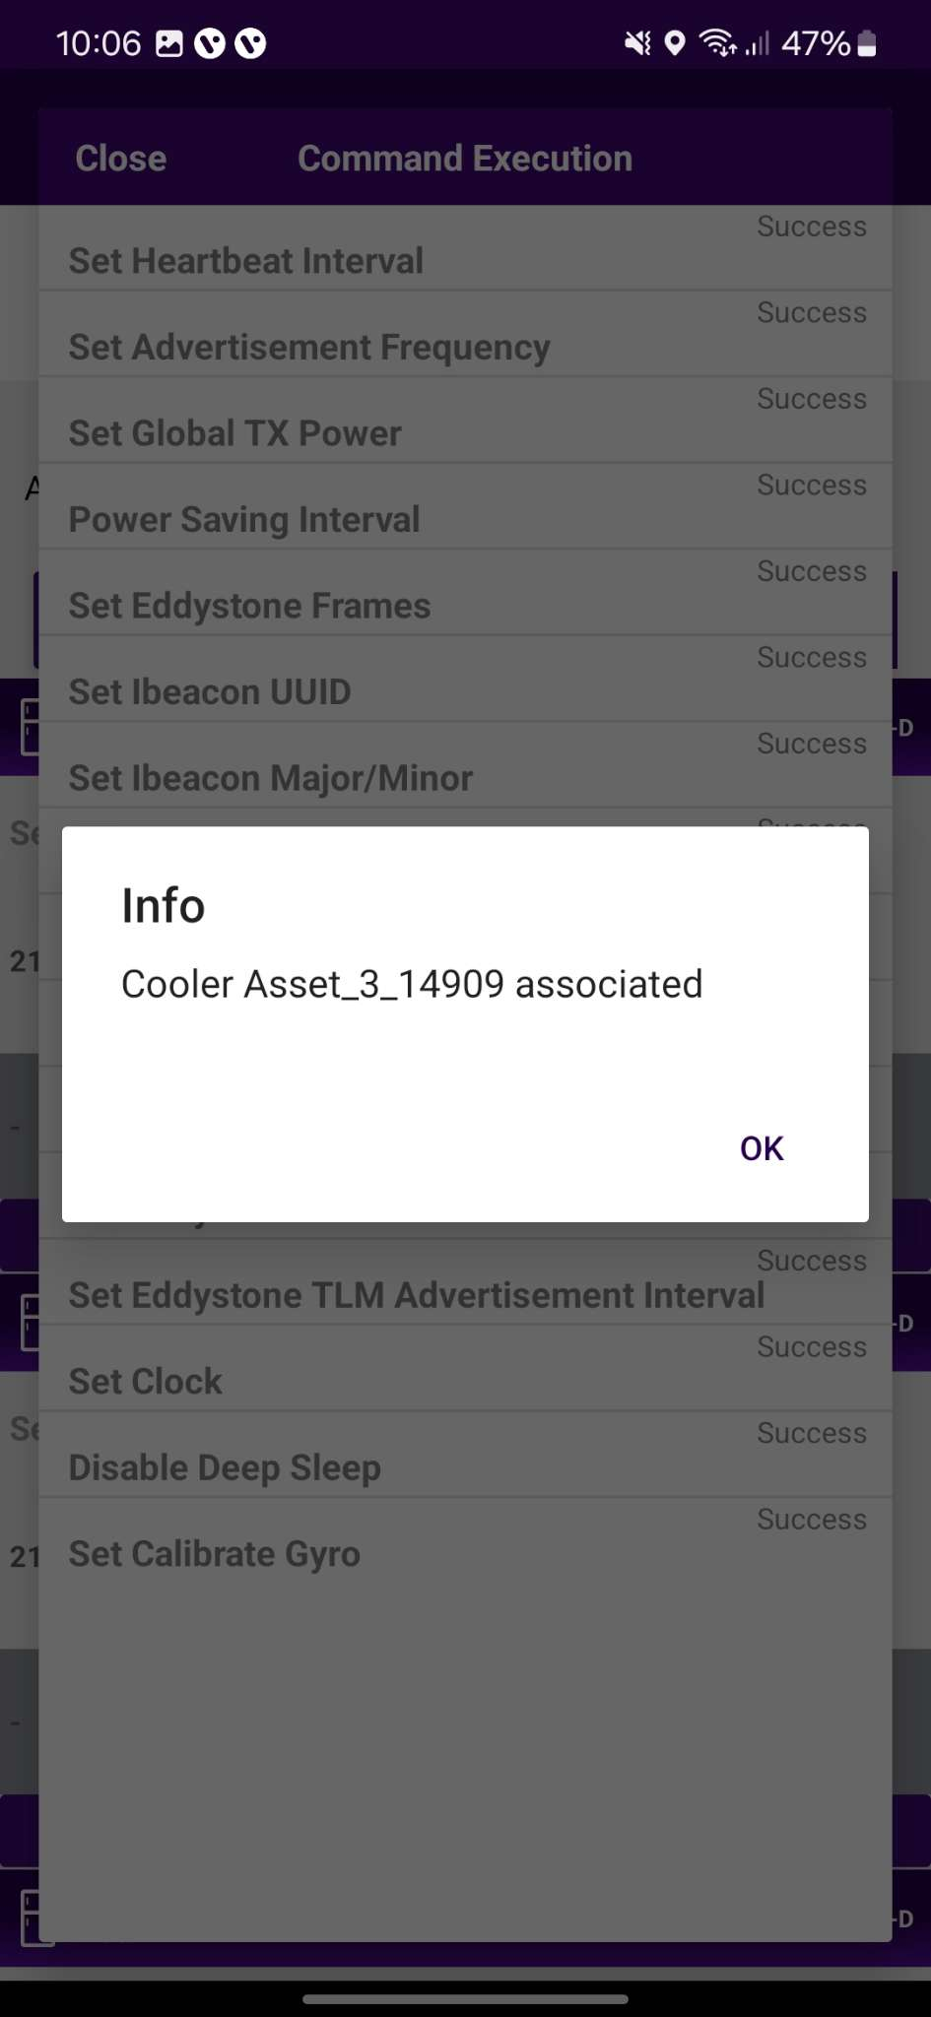
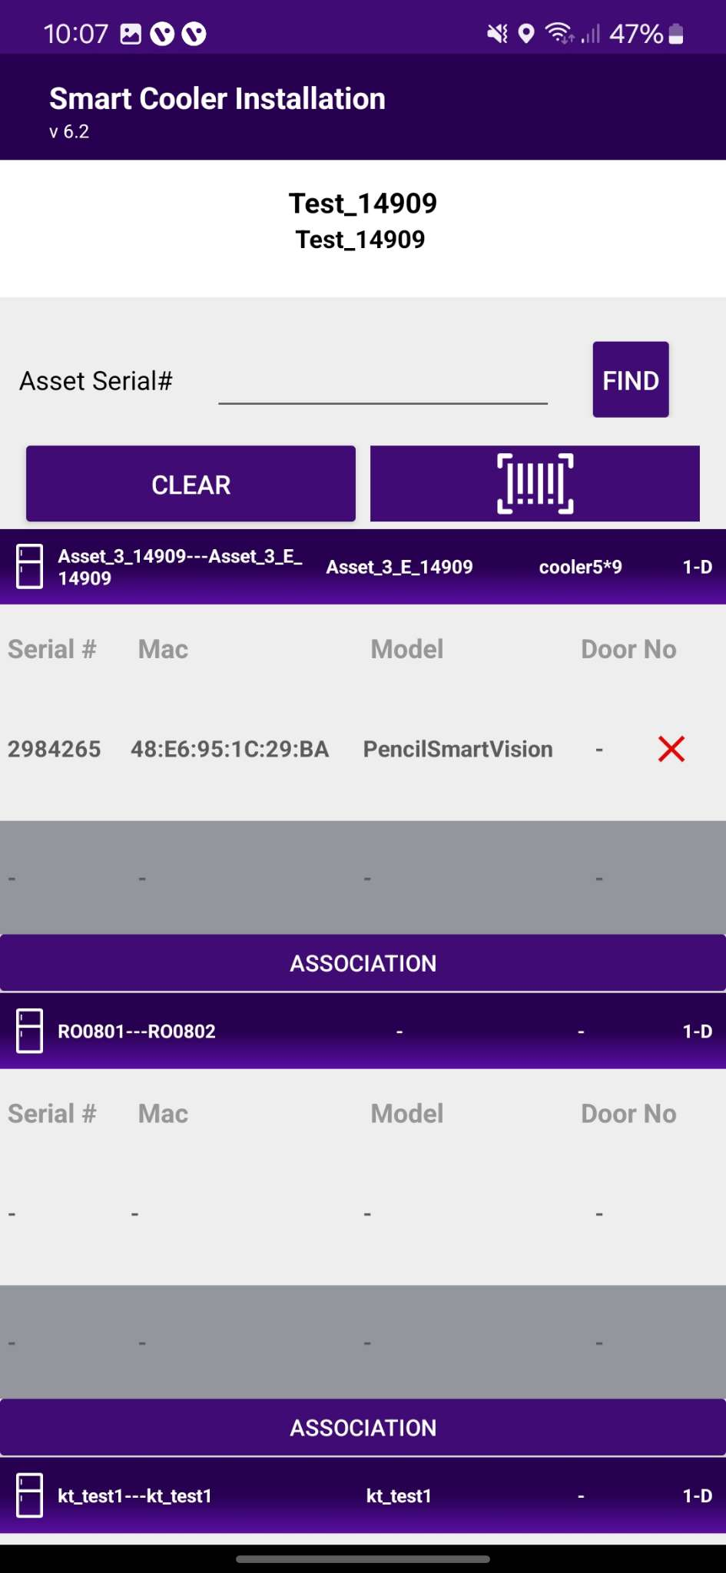
ASSOCIATION – SMART VISION
3. Selecting the Device to do the association with - After identifying the device, select the device to start Installation, App will give a popup to confirm the association, Click on OK to confirm. When the process is completed, the User will be returned to the Outlet Screen, and now the User see that the Smart Vision is associated with the Cooler. When this window appears, the device is Gyroscope calibrated, and the user can press OK to return When the door closes, a screen pop-up will show, click on OK.
4. Smart Device Configuration Setting - On selection of the device, the application will connect to the device, make all configuration changes and provide status a success message will appear after successful association, press OK to close the popup. When this window appears the device is provisioned, and the User can press close to return to the outlet screen.
Note: Please note the device only wakes up when the cooler Door is Closed for 15 seconds.
© 2024 Vision Group

Slide 16
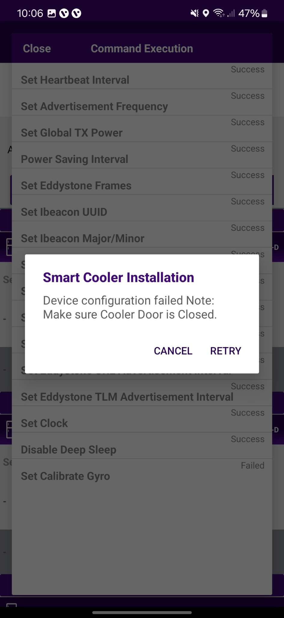
In case the gyro command is not getting a successful response, and it shows waiting or failed.
Waiting
Users can wait for 1 min and if the pop-up does not show then try again.
Failed
Check the door status if it’s “Open” then close the door and Tap on the “Retry”.
© 2024 Vision Group

Slide 17
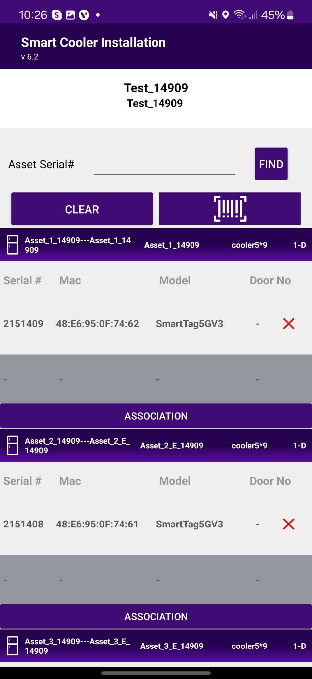
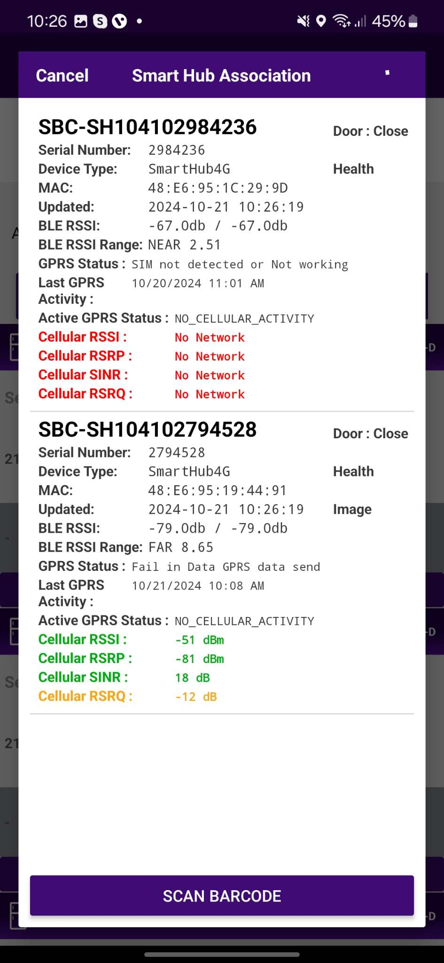
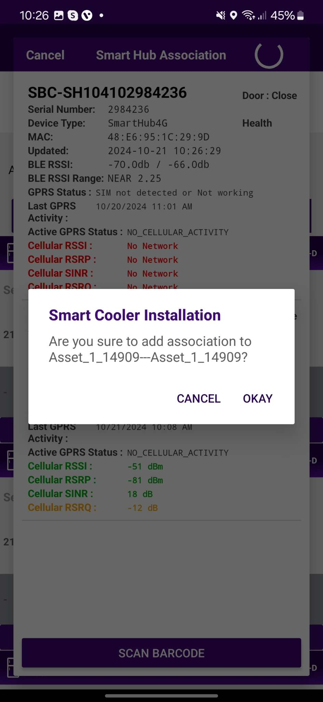
ASSOCIATION – SMART HUB
1. Selecting Cooler - A new window will open allowing the User to select the cooler for the outlet selected manually. Click on “Association” to choose the asset to install.
2. Selecting Smart Device type - A new window will open to ask for the selection of device types to be associated with. Click on “SMART HUB ” to Associate the SmartHUB device. Now Power on the Smart HUB device.
Note: Please note the gateway device is powered on at association time.
© 2024 Vision Group

Slide 18
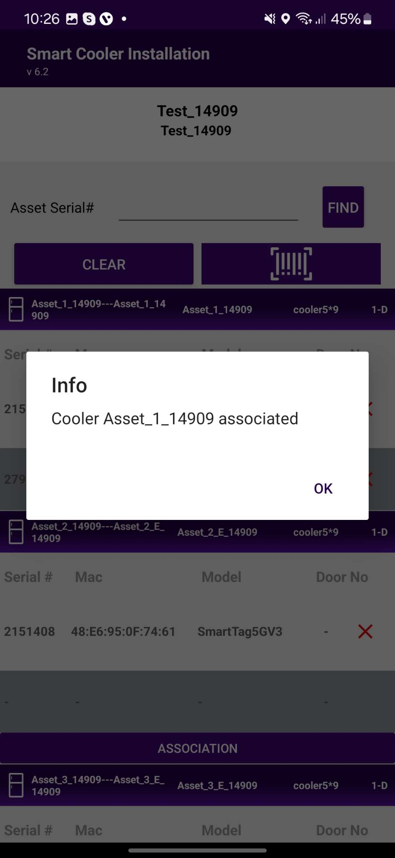
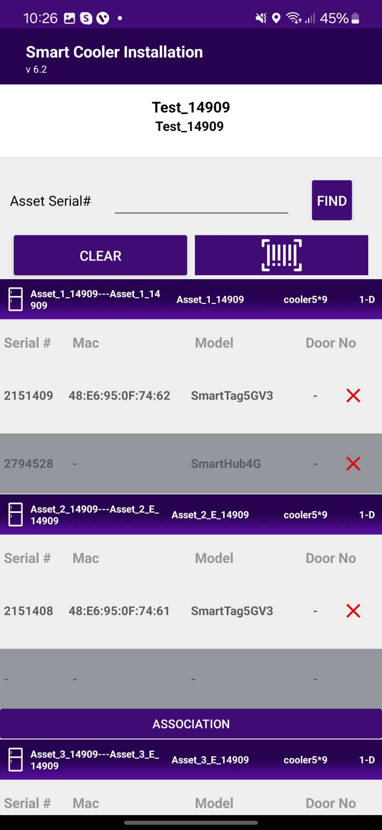
3. Selecting the Device to do the association with - After identifying the device, select the device to start Installation, App will give a popup to confirm the association, Click on OK to confirm. When the process is completed, the User will be returned to the Outlet Screen, and now the User see that the Smart Hub is associated with the Cooler.
© 2024 Vision Group

Slide 19
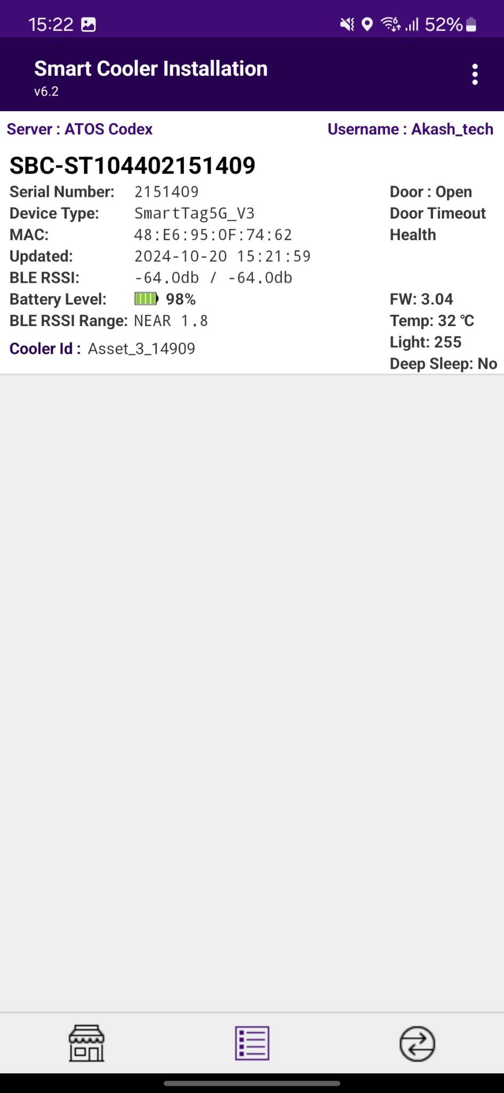
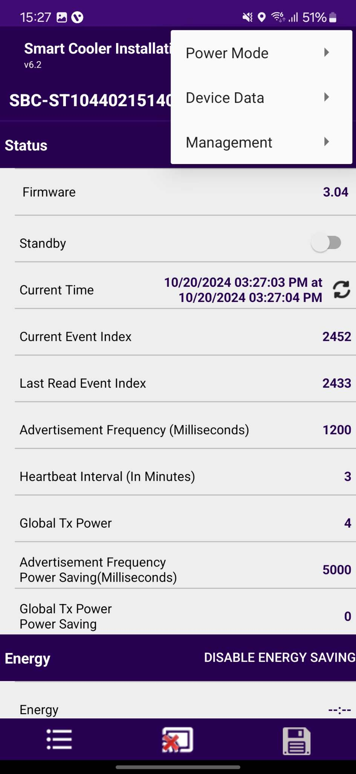
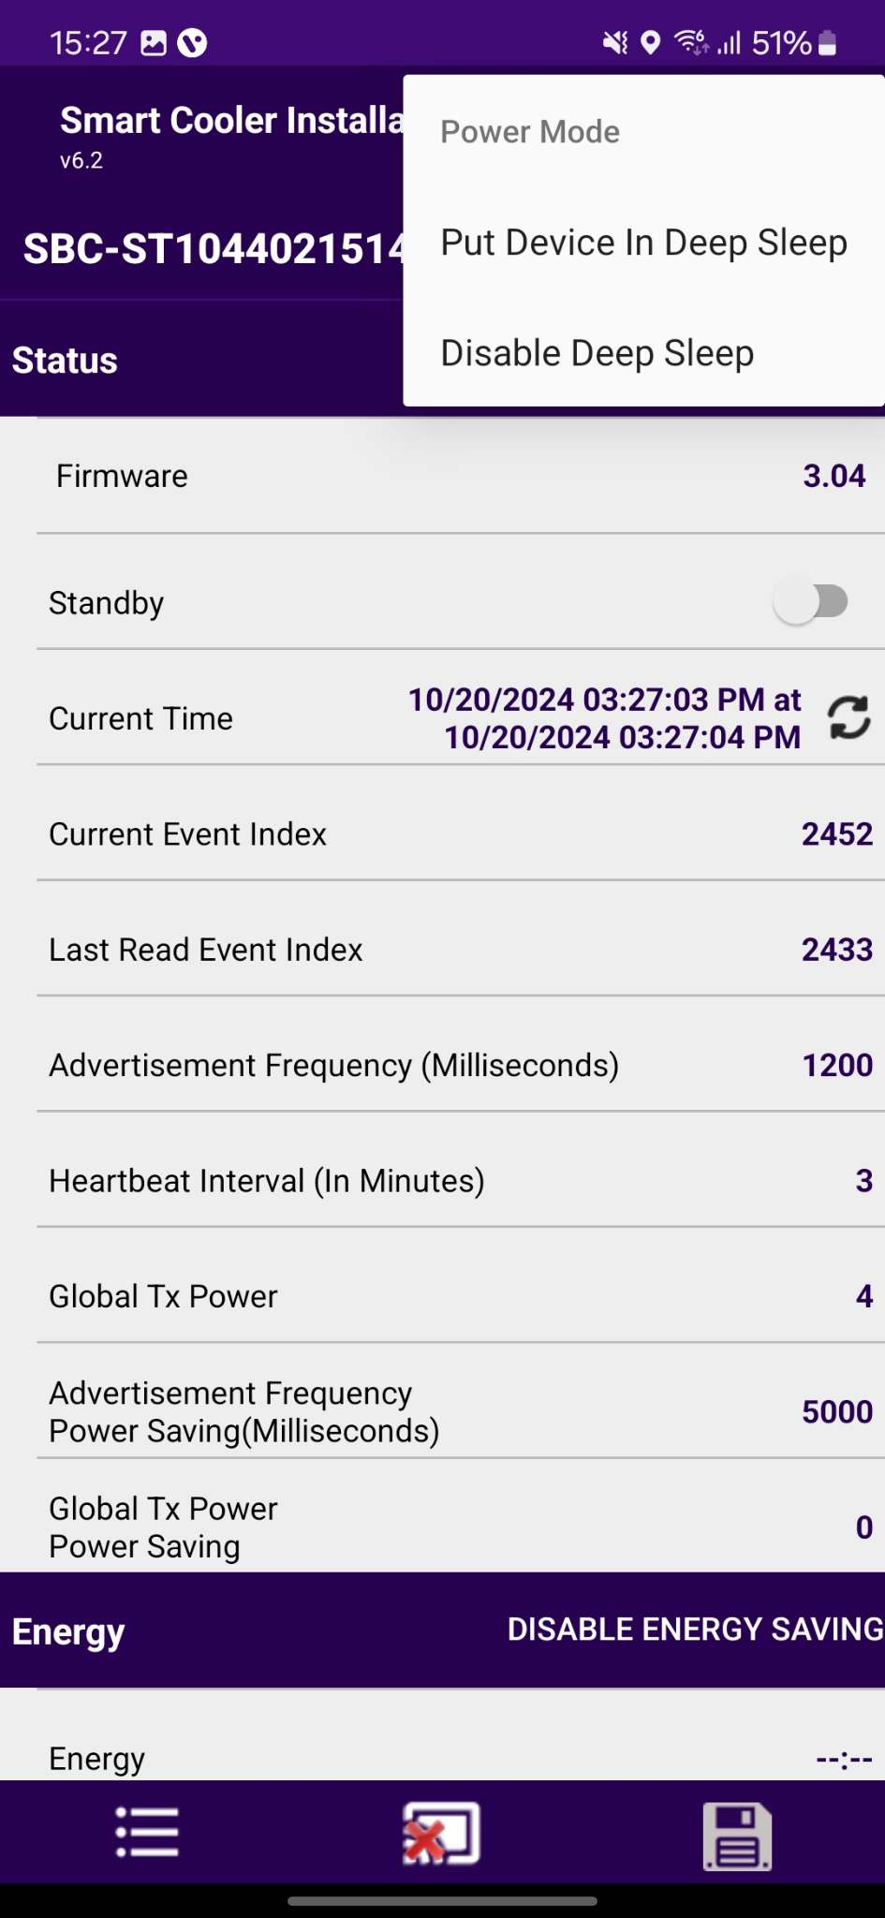

CONFIGURATION - DEEP SLEEP MODE
In Deep-sleep mode, the device neither advertises nor logs any event data. Deep sleep mode is by default enabled when installed in the field the first time.
A. To Disable Deep Sleep - To disable deep sleep mode, the user must keep the door magnet close to the device then the device starts advertising for 30 seconds. user must connect within 30 seconds to a smart device, Tap on Smart Device and After the connection, go to Menu > “Power Mode” > “Disable Deep Sleep”.
After disabling deep sleep mode, the device will continuously advertise forever and log event data.
If the user doesn't disable deep sleep mode, then after 30 seconds of disconnection, the device will stop advertisement again and the user can’t see the device in scanning.
B. To Enable Deep sleep - After connection, go to Menu > “Power Mode” > “Put Device in Deep Sleep”.
After enabling deep sleep mode, the device will stop advertising and won’t log any event.
B
A
© 2024 Vision Group

Slide 20
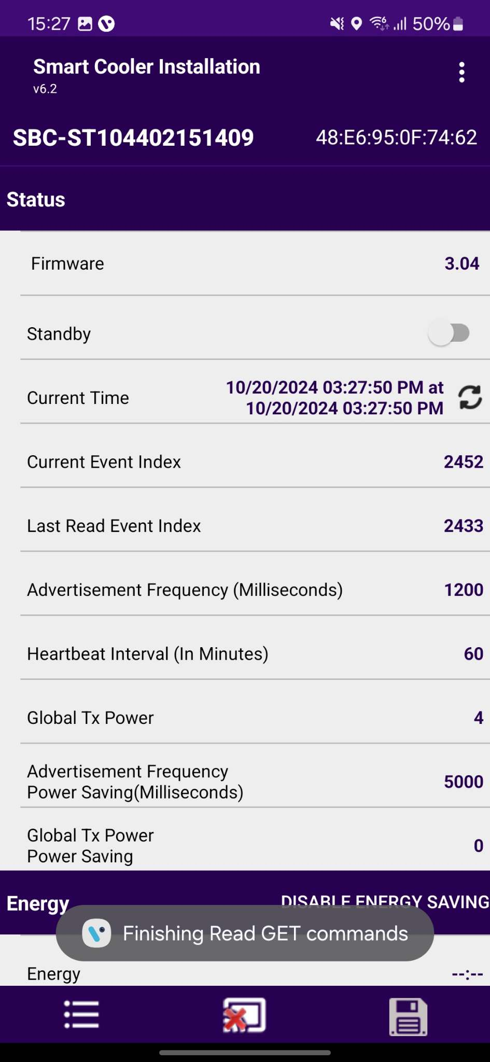
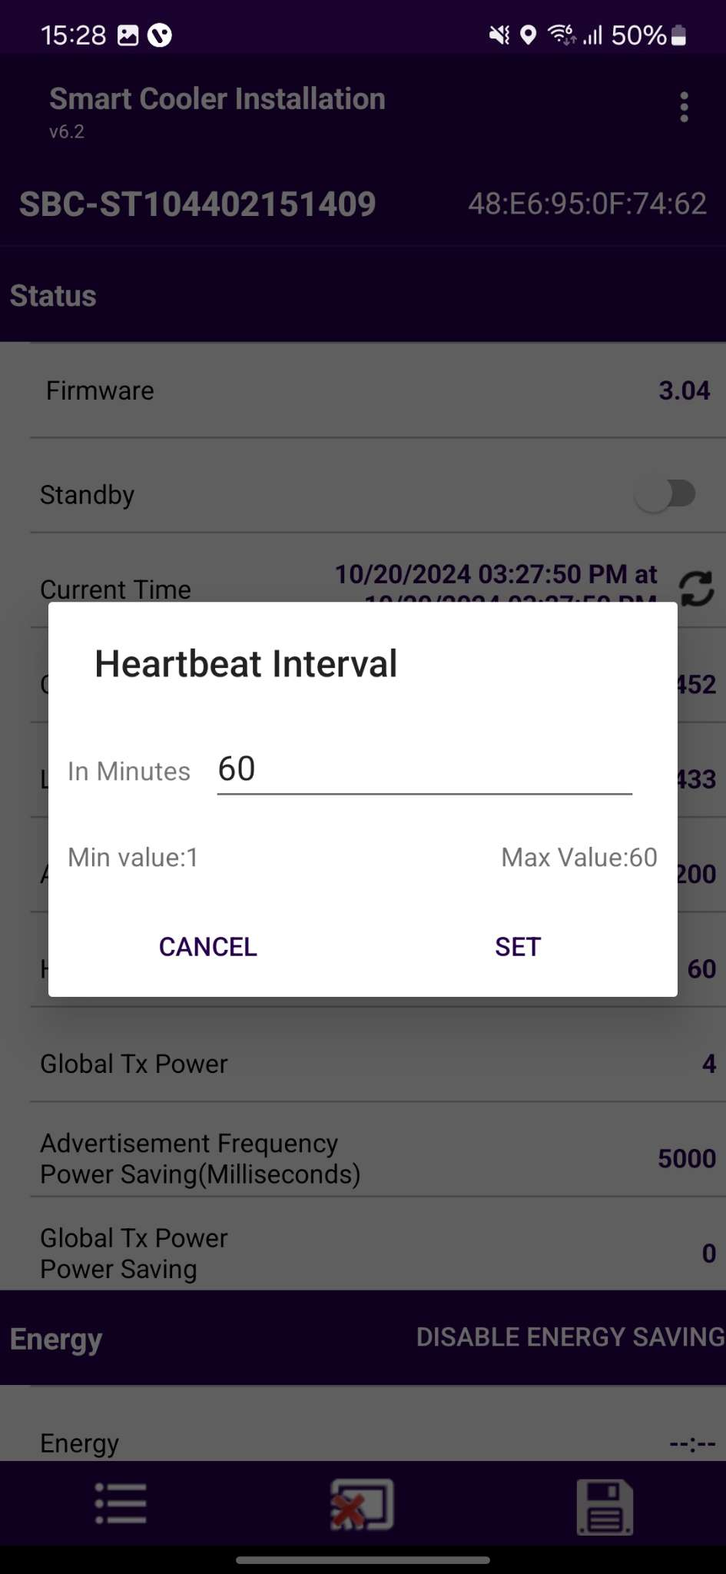
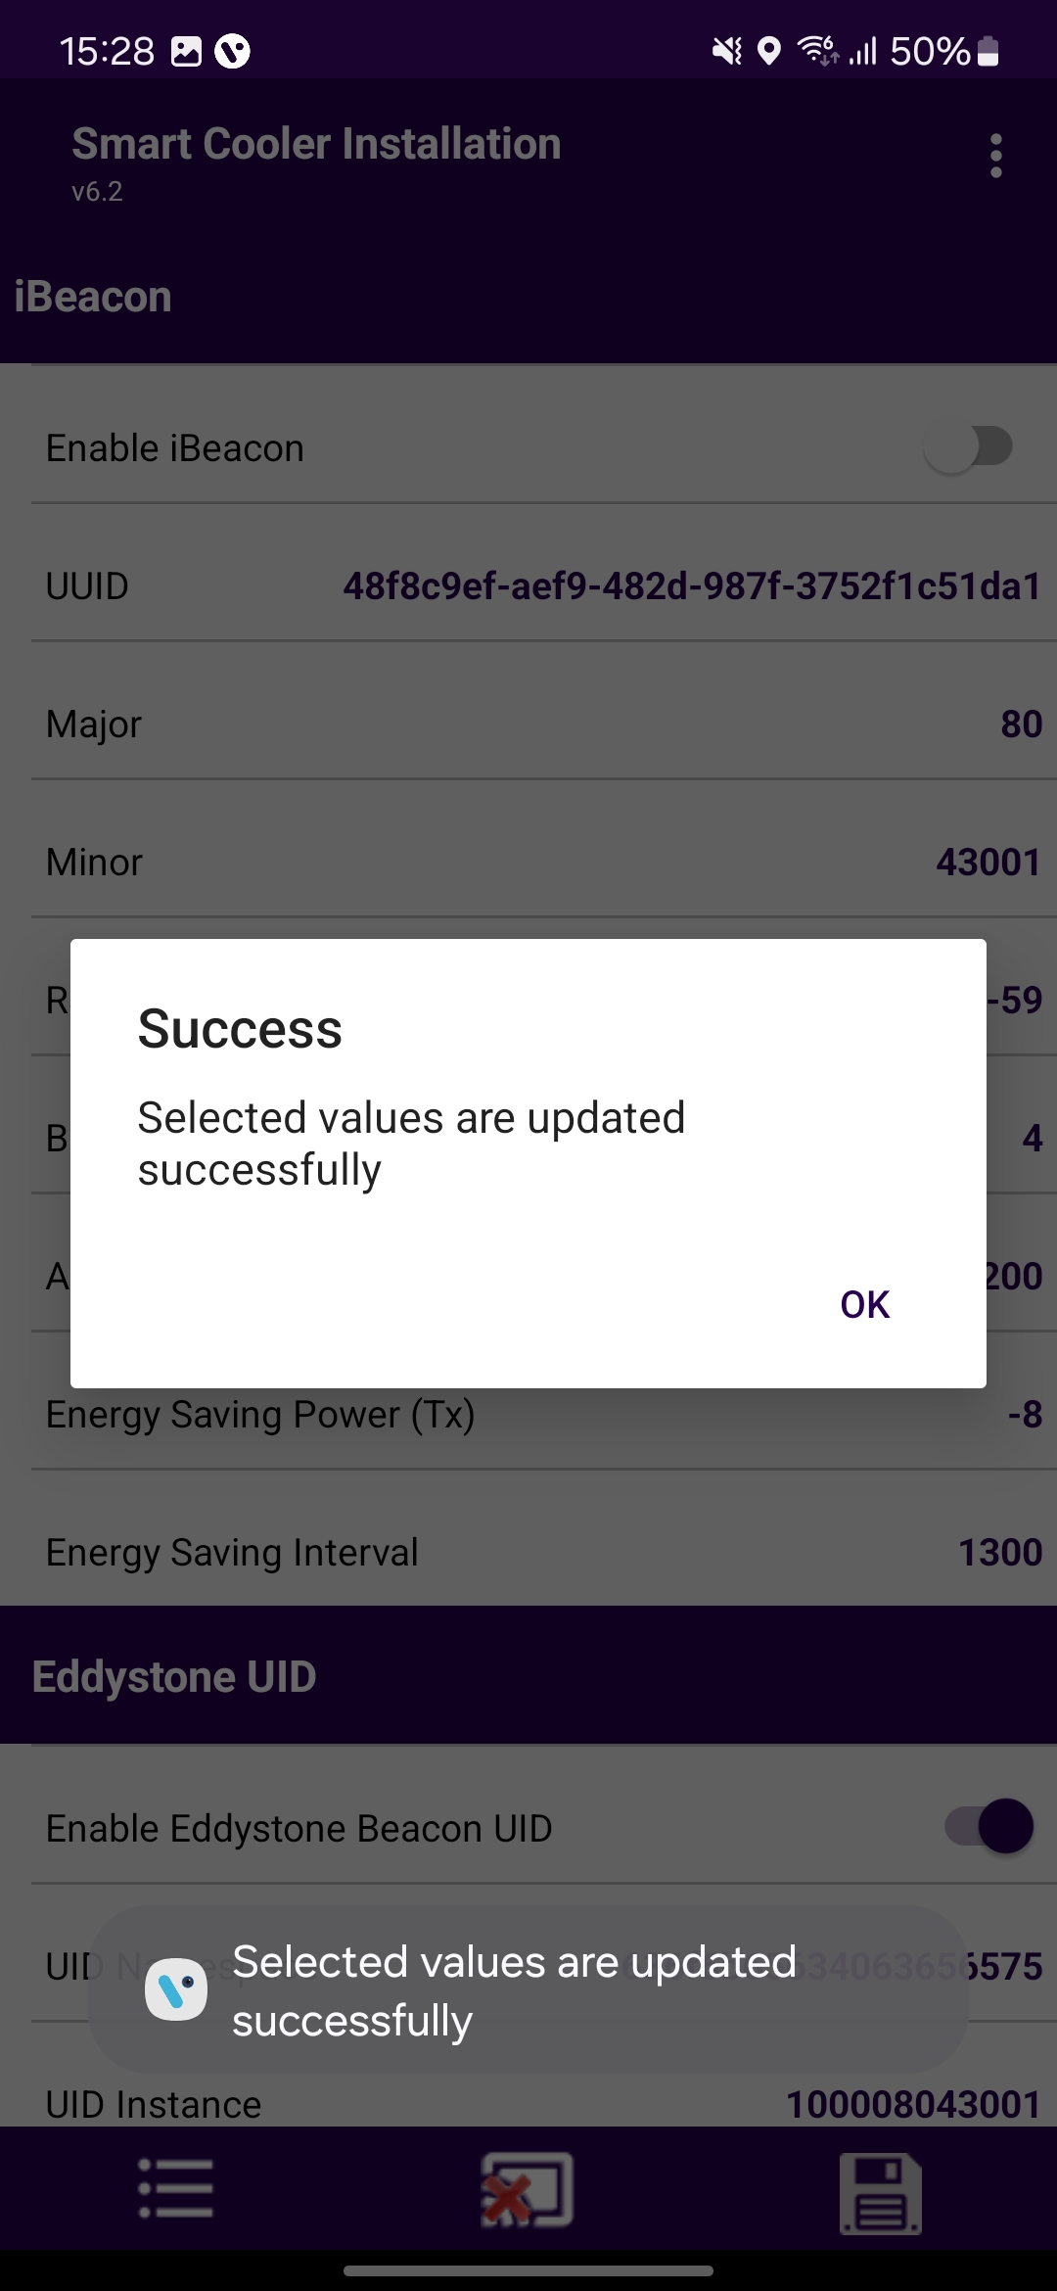
CONFIGURATION - SET HEALTH INTERVAL
After connecting with the device, the user can configure the following parameters.
In the STATUS Parameters, Tap on “Heartbeat Interval (In Minutes)”.
A. Enter the Interval Value and press the “Set” button.
B. After changing the values, press the SAVE button at the bottom to save it on the device.
A
B
© 2024 Vision Group

Slide 21
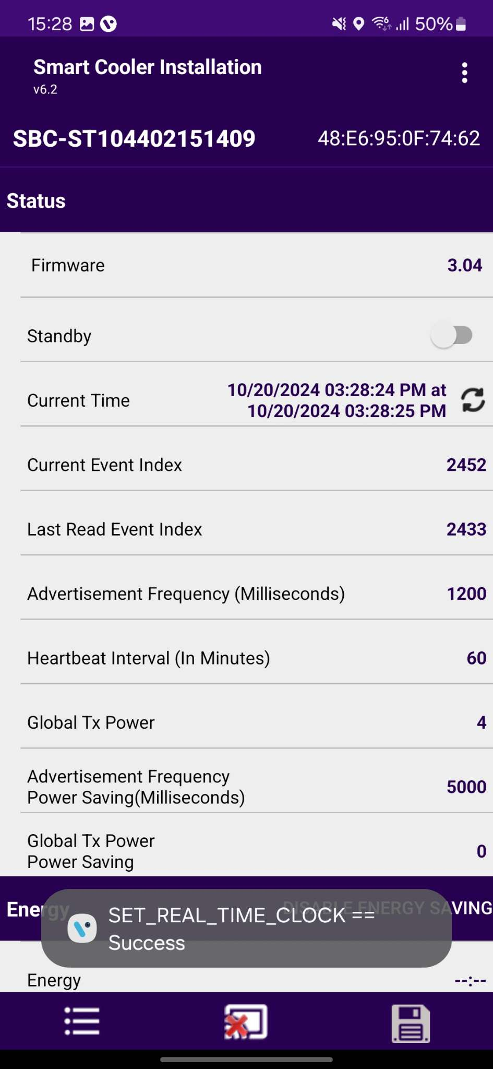
CONFIGURATION - SET CURRENT DATE TIME
After connecting with smart devices, Tap on the Refresh button in STATUS > “Current Time” row to set the current time in the device.
After a Successful set, the clock time Popup message will show.
© 2024 Vision Group

Slide 22
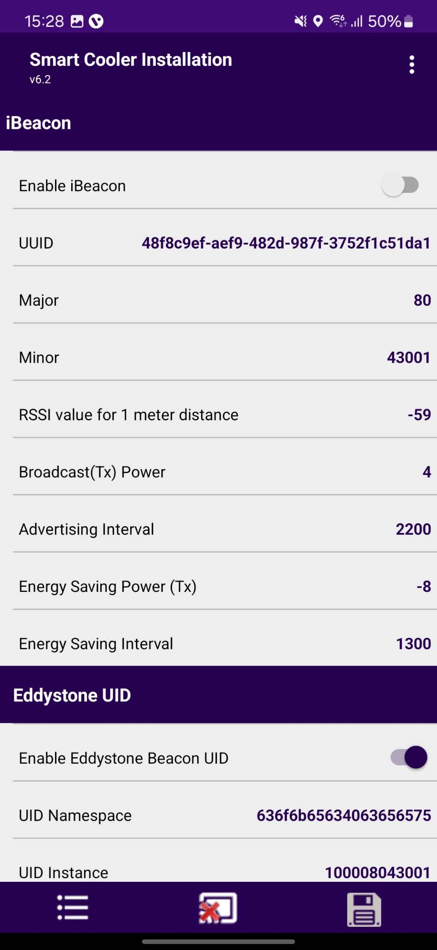
CONFIGURATION - SET IBEACON PARAMETERS
Enable/Disable iBeacon Frame
Toggle button to Enable iBeacon row to enable or disable the iBeacon frame in the iBeacon Raw.
After changing the values, press the SAVE button at the bottom to save it on the device.
© 2024 Vision Group

Slide 23
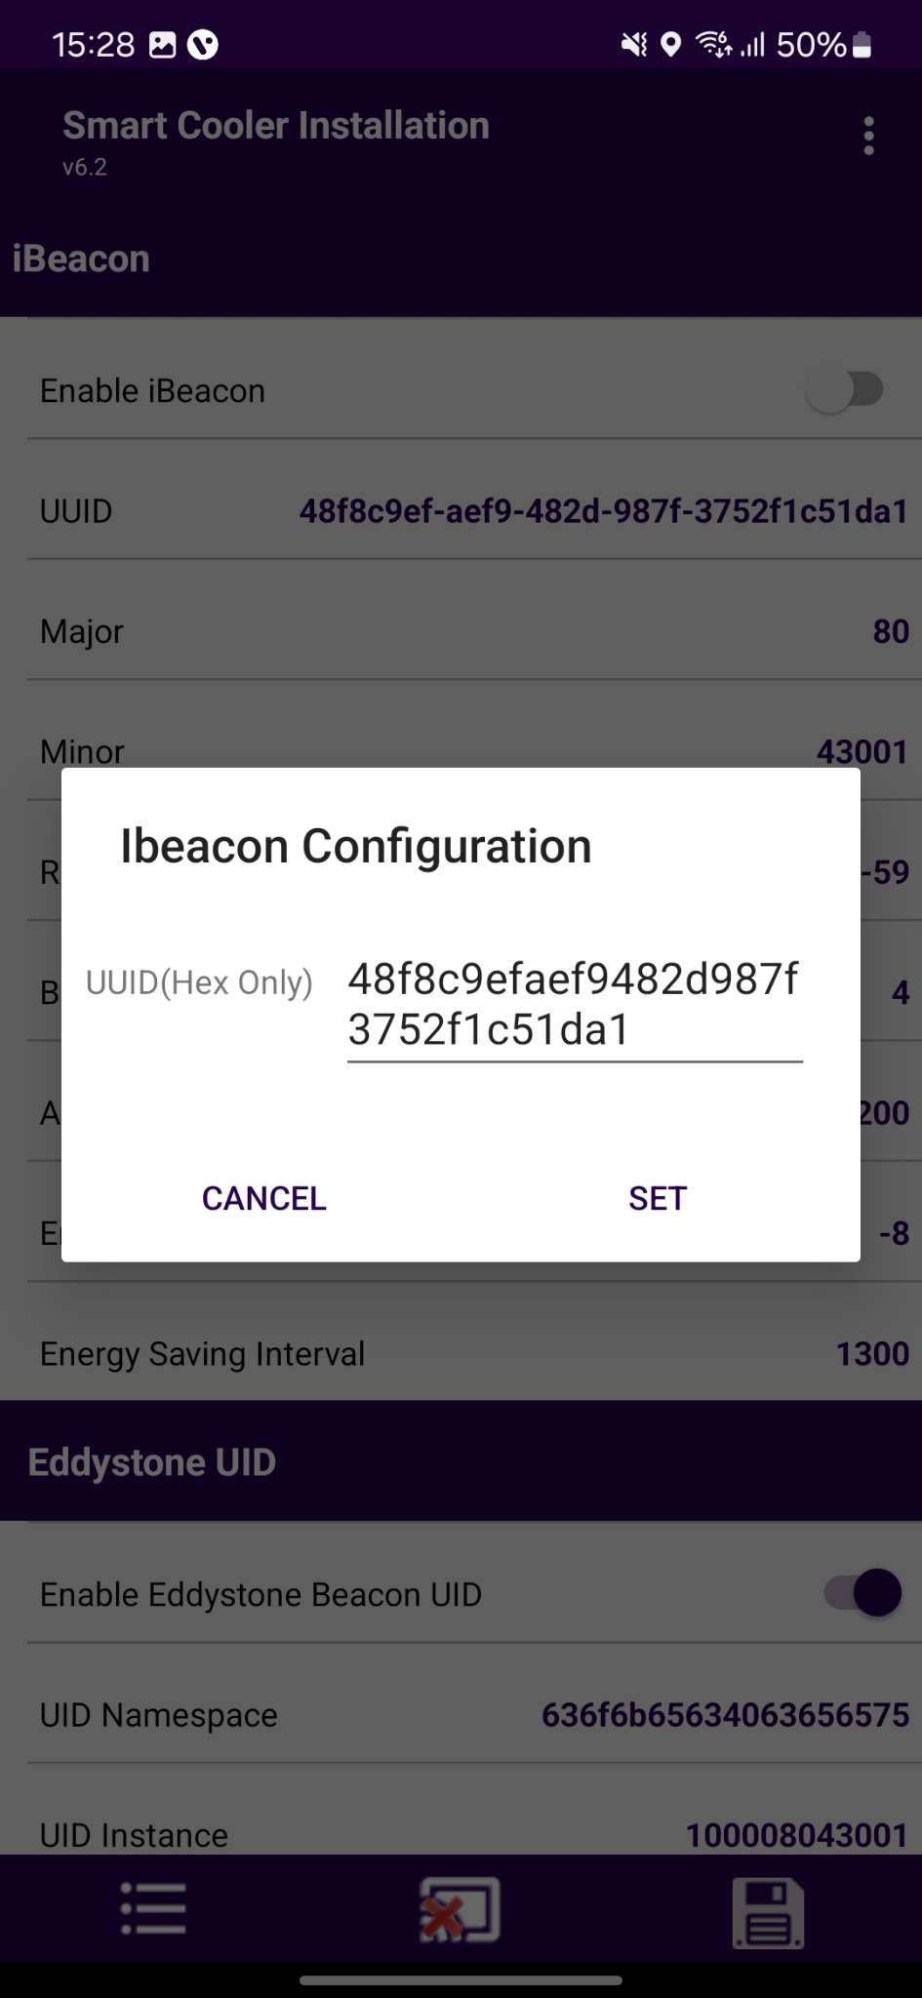
CONFIGURATION - SET IBEACON PARAMETERS (CONT’D)
Set UUID
After connection, as shown in the figure, below the iBeacon bar touch on the UUID row.
Enter a 16-byte UUID and press “Set”.
After changing the values, press the SAVE button at the bottom to save it on the device.
© 2024 Vision Group

Slide 24
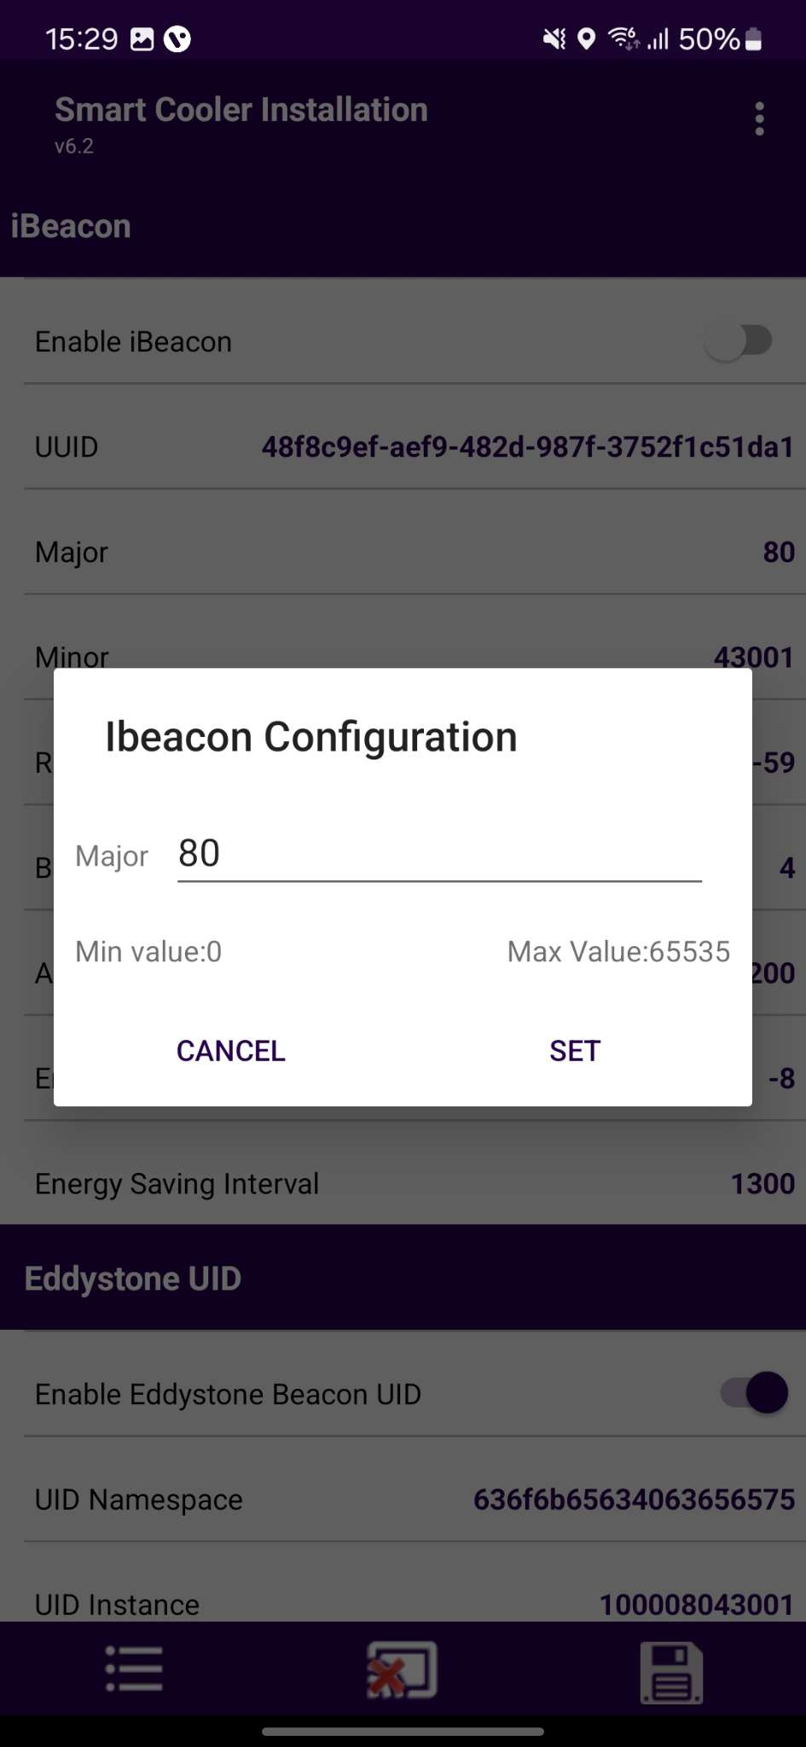
CONFIGURATION - SET IBEACON PARAMETERS (CONT’D)
Set Major
After connection, as shown in the figure, below the iBeacon bar, there is a row for Major. Click on any row and write the value as shown below.
Enter the value and press “Set”.
After changing the values, press the SAVE button at the bottom to save it on the device.
© 2024 Vision Group

Slide 25
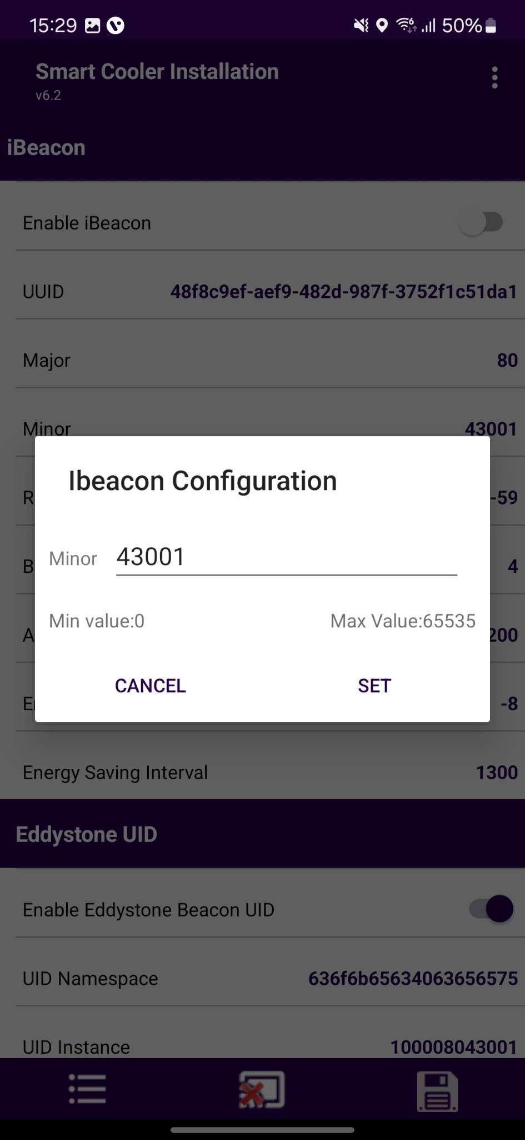
CONFIGURATION - SET IBEACON PARAMETERS (CONT’D)
Set Minor
After connection, as shown in the figure, below the iBeacon bar, there is a row for Minor. Click on any row and write the value as shown below.
Enter the value and press “Set”.
After changing the values, press the SAVE button at the bottom to save it on the device.
© 2024 Vision Group

Slide 26
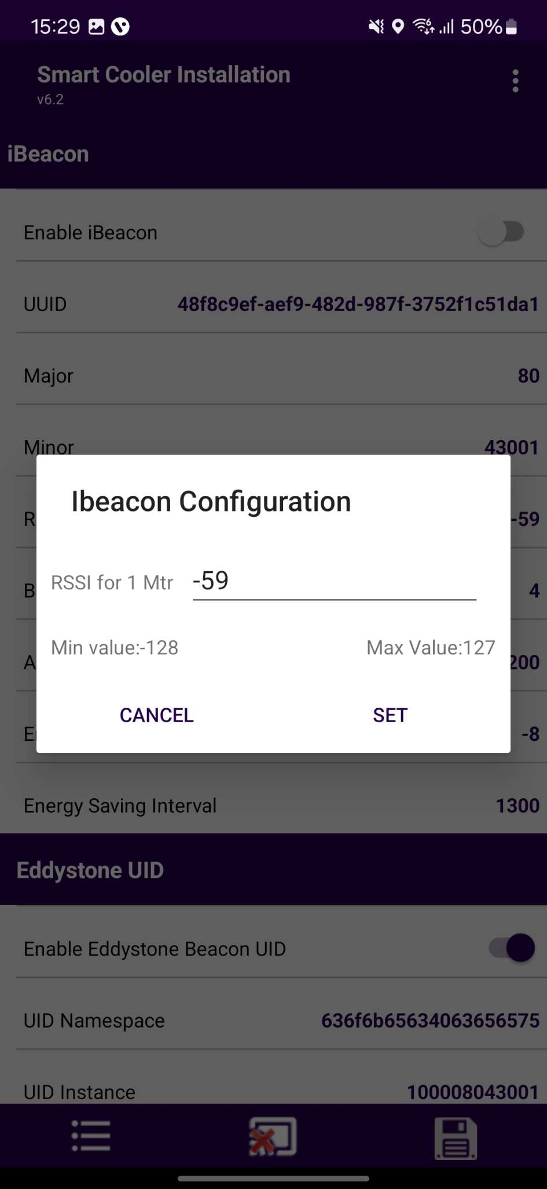
CONFIGURATION - SET IBEACON PARAMETERS (CONT’D)
Set RSSI
After connection, as shown in the figure, below the iBeacon bar, there is a row for RSSI. Click on any row and write the value as shown below.
Enter the value and press “Set”.
After changing the values, press the SAVE button at the bottom to save it on the device.
© 2024 Vision Group

Slide 27
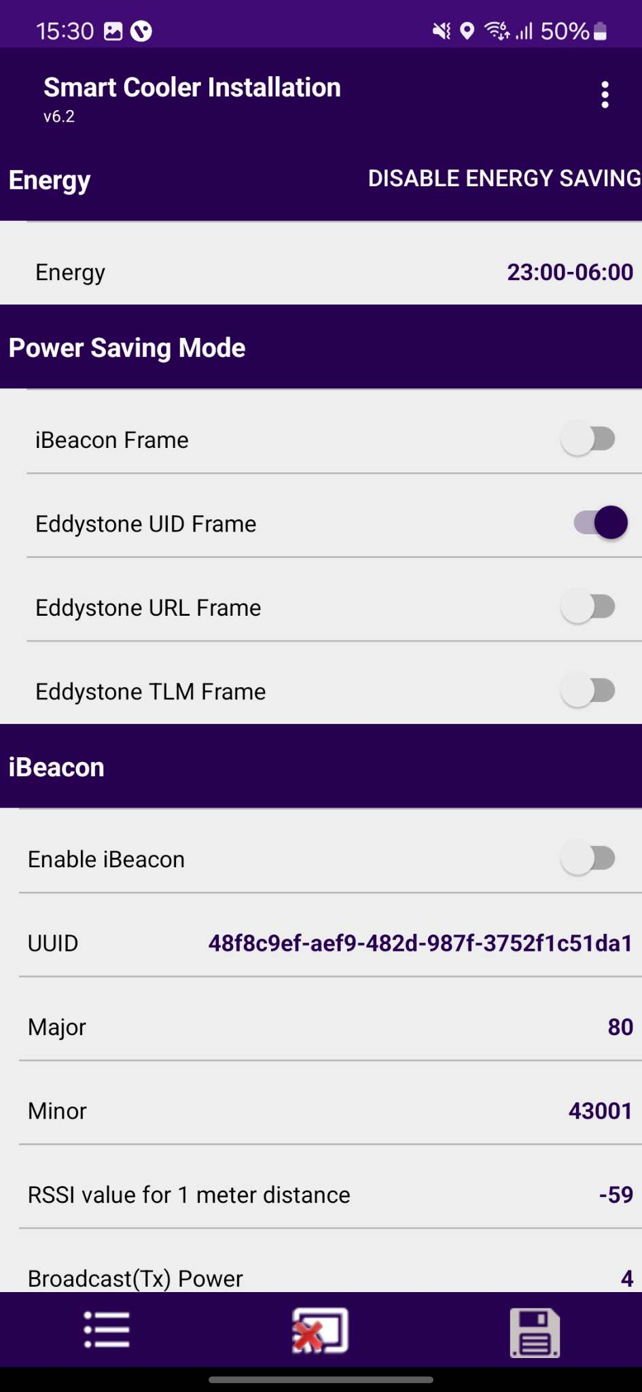
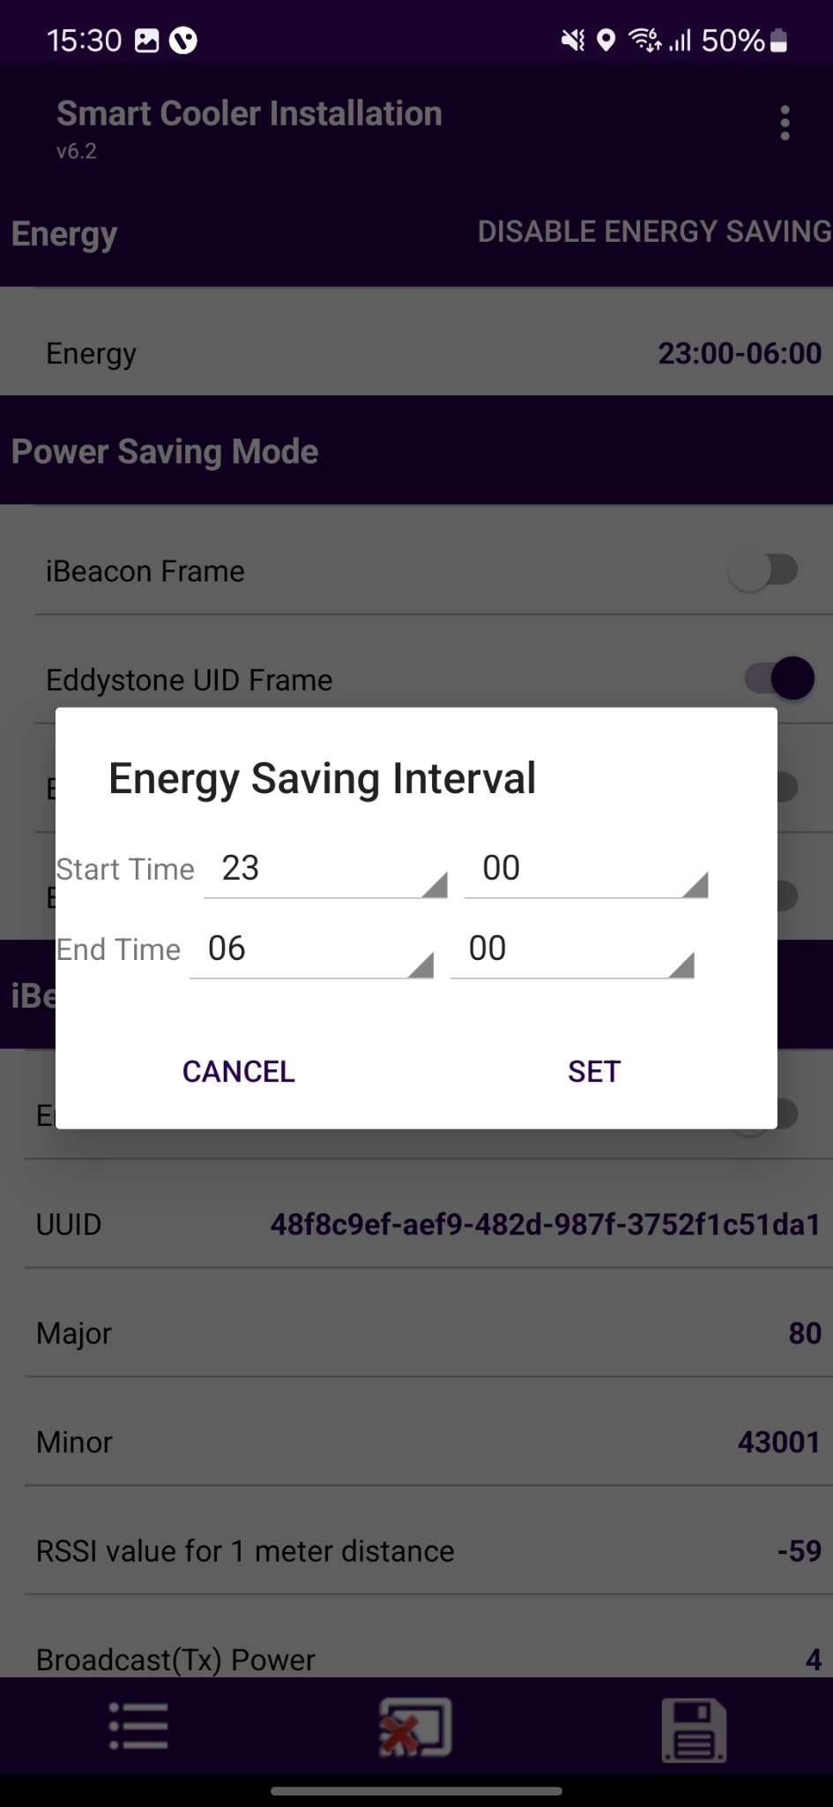
CONFIGURATION - ENERGY SAVING MODE
Set Energy saving mode
Users can set the time duration for saving the power by changing the advertisement interval and it transmits power for that user need to touch on the row Energy Saving Start/End time.
After changing the values, press the SAVE button at the bottom to save it on the device.
© 2024 Vision Group

Slide 28
CONFIGURATION - ENERGY SAVING MODE (CONT’D)
Disable Energy Saving Mode
Users can disable the energy-saving mode by tapping on the “Disable Energy Saving” as shown in the image.
After changing the values, press the SAVE button at the bottom to save it on the device.
© 2024 Vision Group

Slide 29
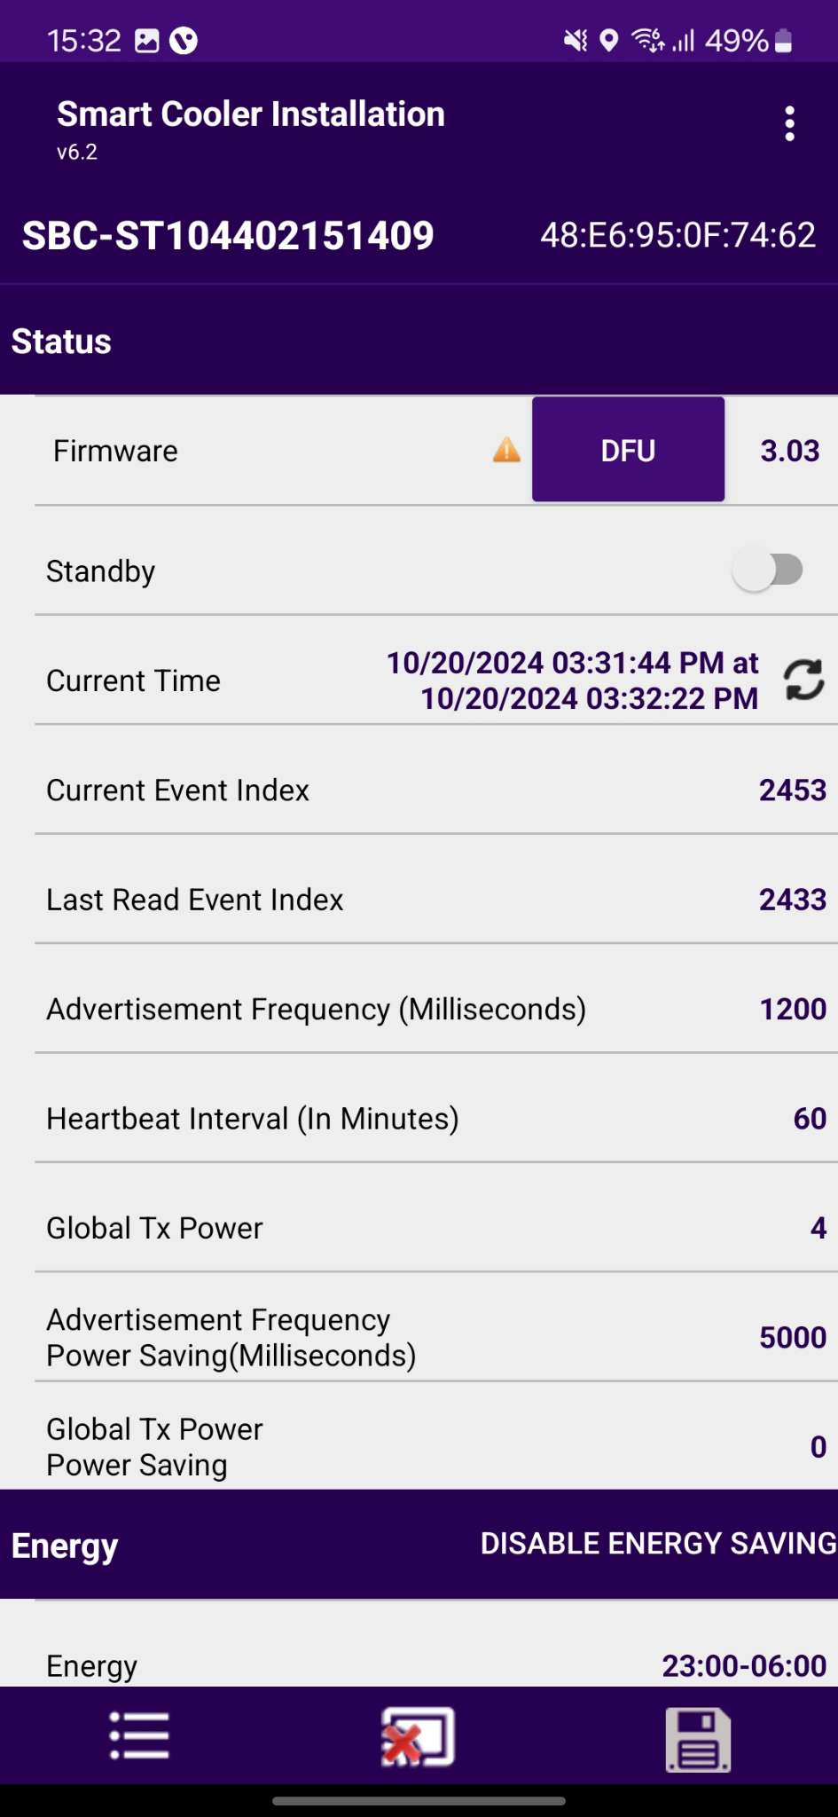
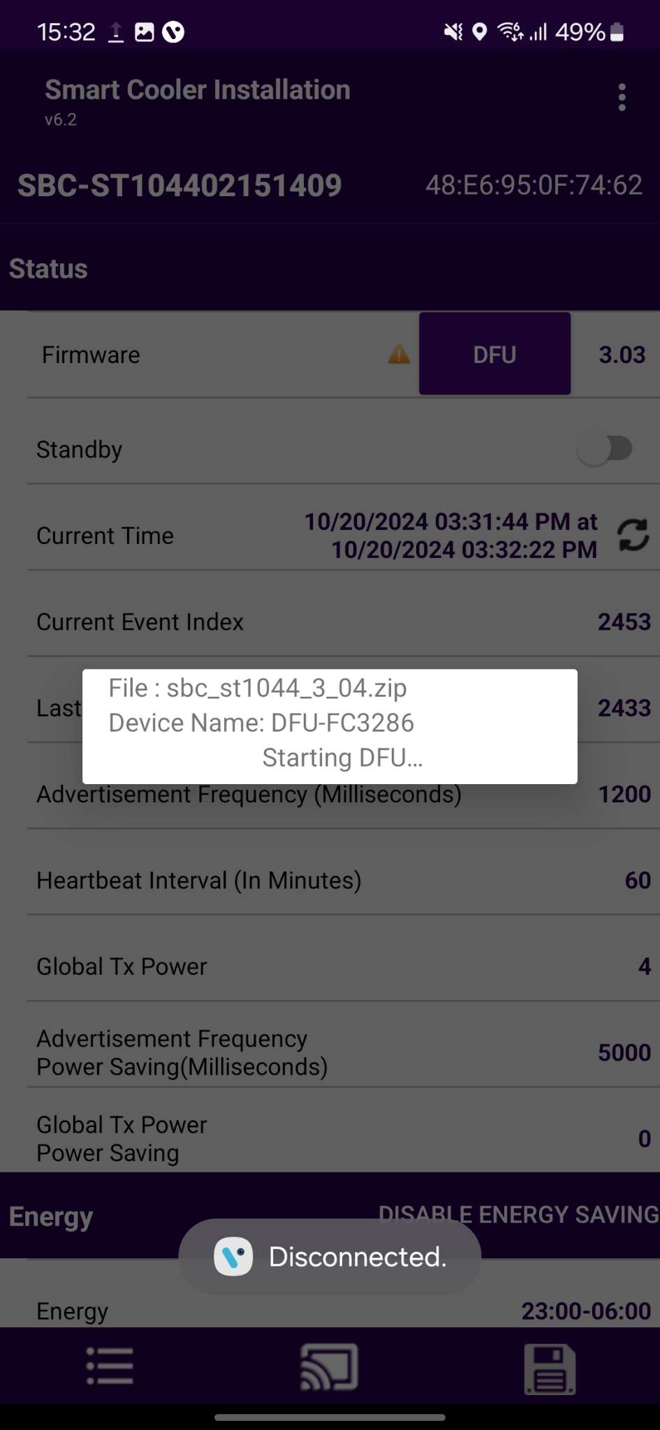
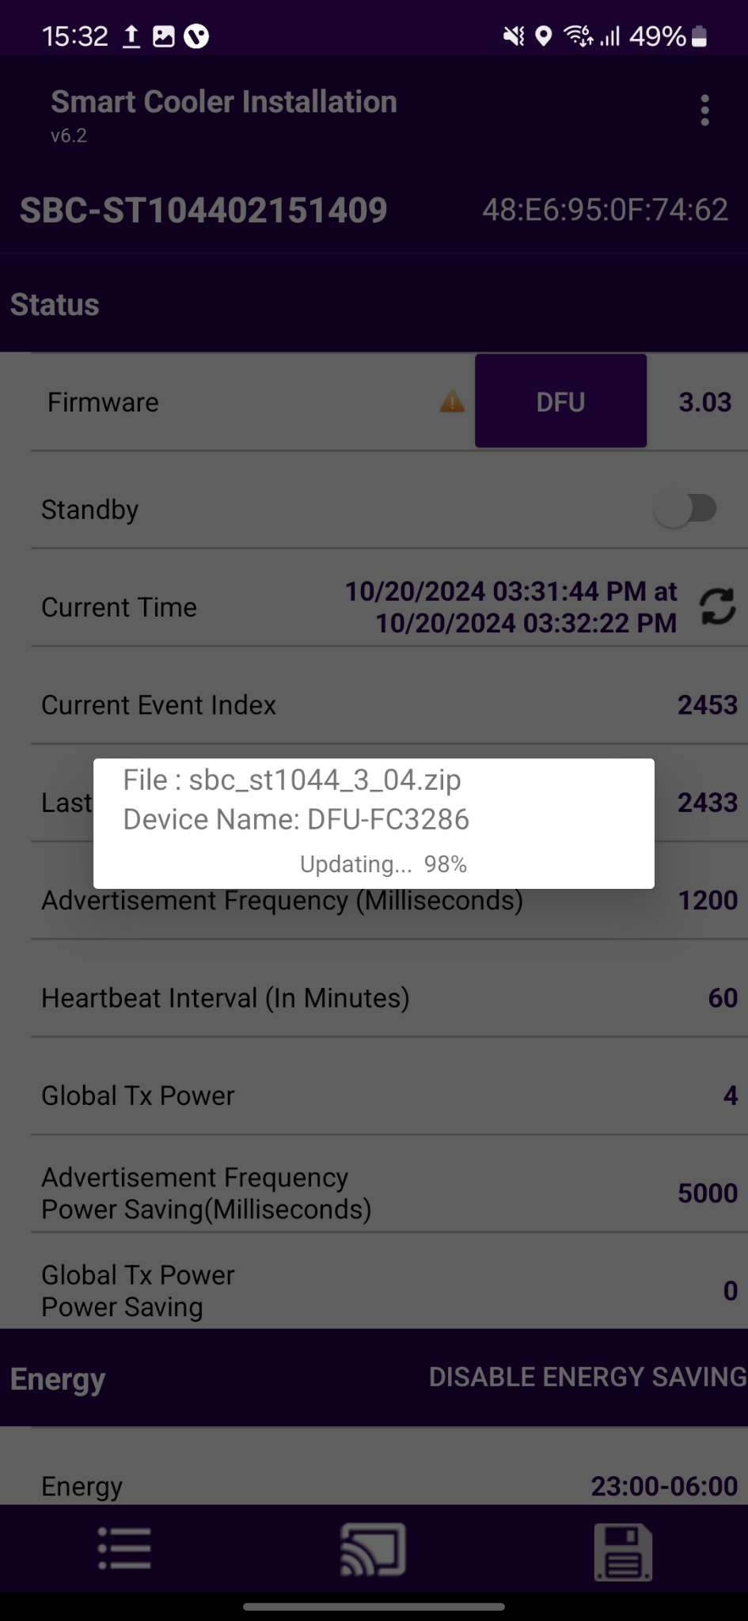

CONFIGURATION – DFU (DIRECT FIRMWARE UPDATE)
DFU - Direct Firmware Update- The DFU of the Smart device can be performed by clicking on the Update DFU Button as shown in the image. If the Device has already the latest Firmware, then there is no DFU Flag show.
After completing the DFU update, the user will see the DFU Upgrade Process. Once the DFU process is successfully finished, the user can view the upgraded firmware version of the smart device.
© 2024 Vision Group

Slide 30
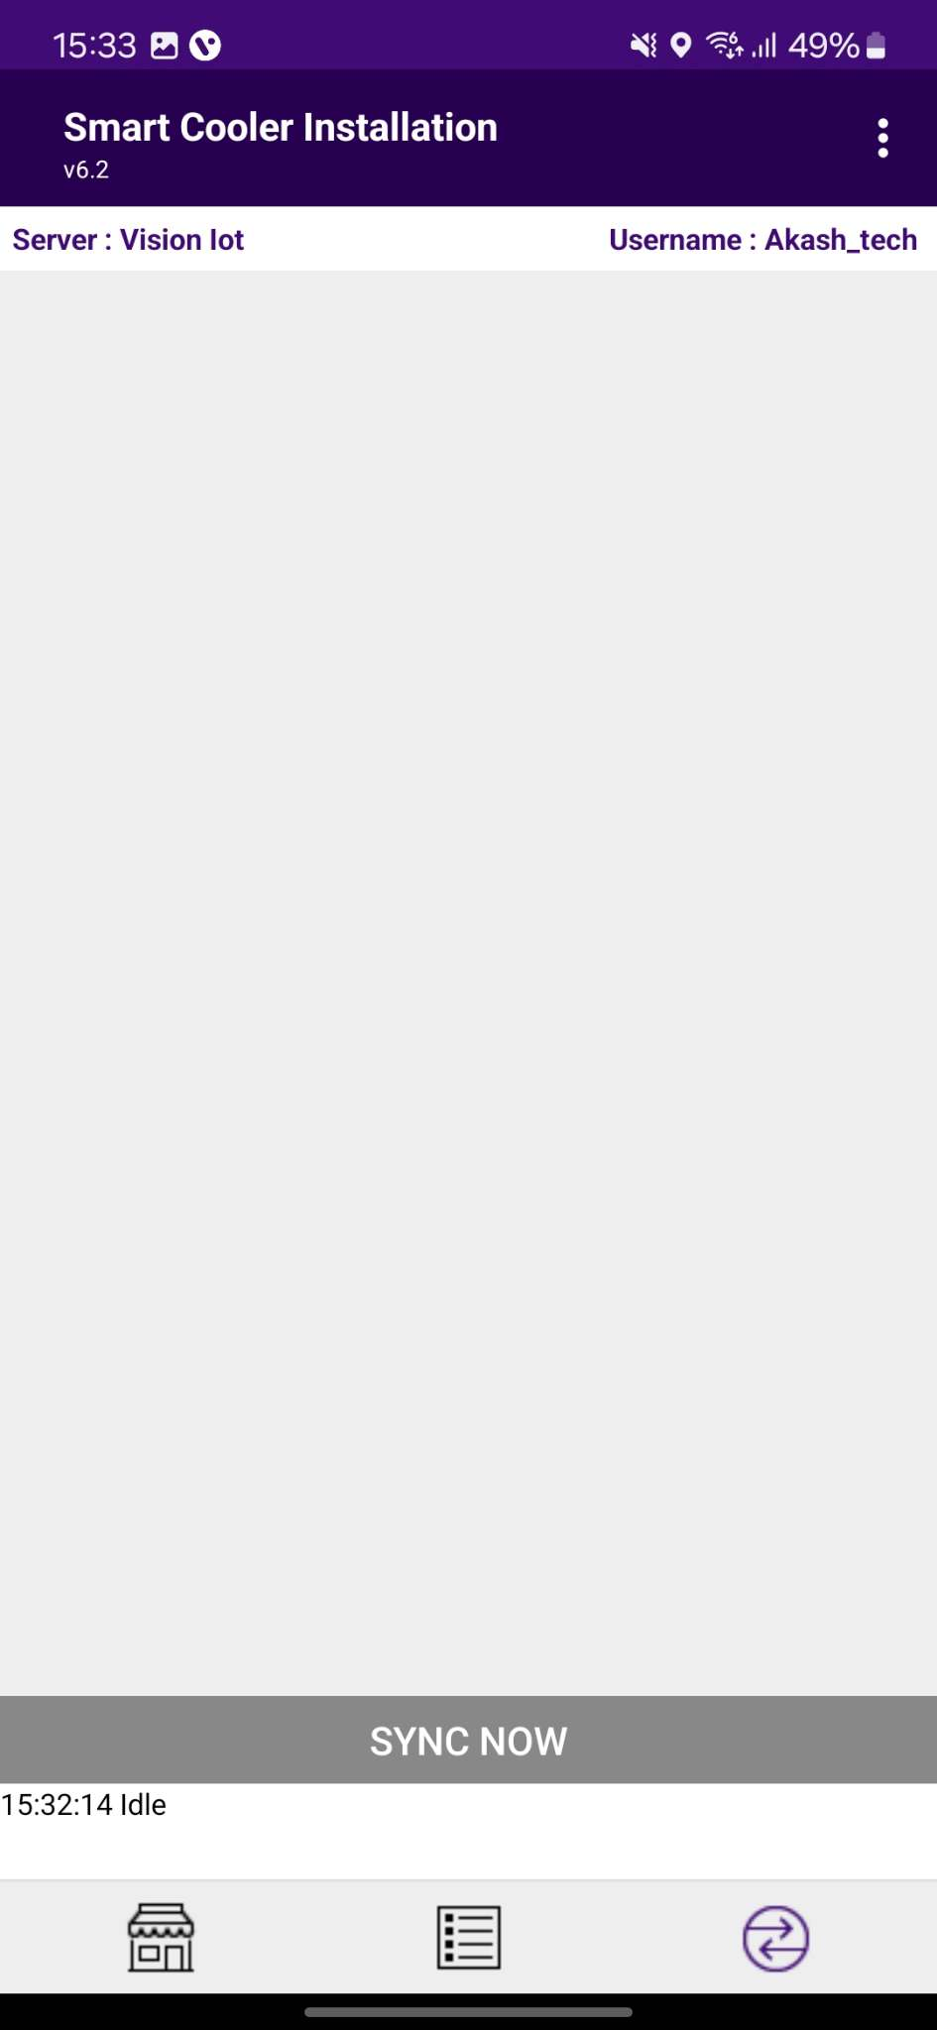
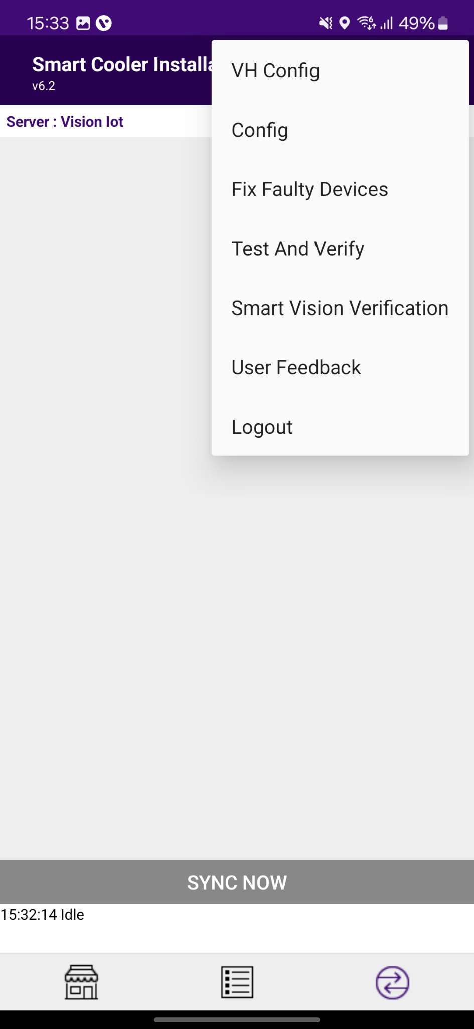
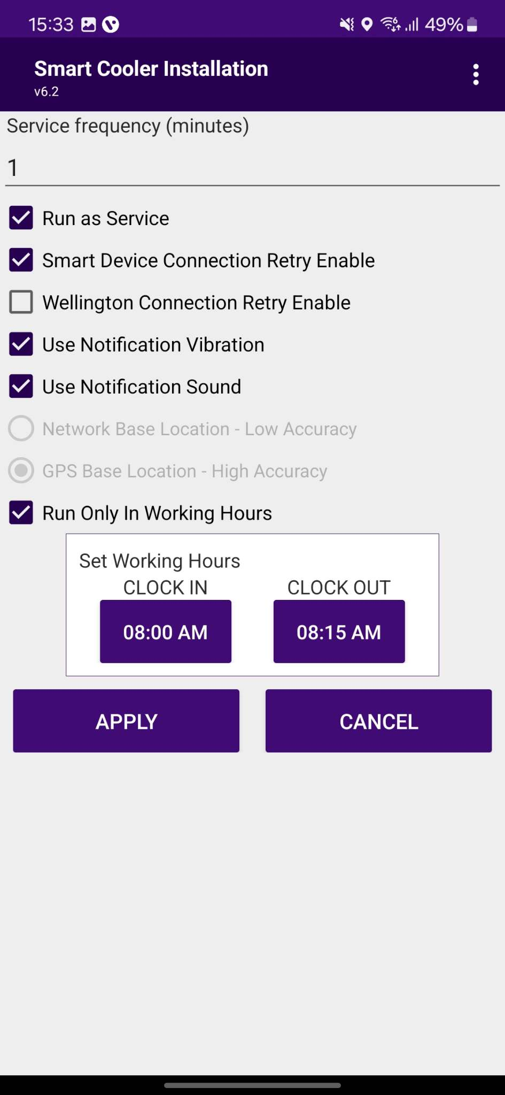
VH PROCESS (VIRTUAL HUB SCREEN PROCESS)
Select the Hamburger Menu(3 Dots/Options Menu) and then Select VH to access the VH Settings.
Run as Service must be checked to activate the VH.
After Checking any one of the above, select “APPLY” to commit the settings.
© 2024 Vision Group

Slide 31
VIRTUAL HUB – SETTINGS/OPTION FOR VH SERVICES
1
Service Frequency: This is the delay between consecutive VH sessions.
Run as Service: Check this option if the VH must run.
Connection Retry Option: If Smart Device or Wellington does not connect in one try then it’s used.
Use GPS Service: Check this option if the GPS service must be used to capture the location of the user.
Working Hours: VH will work during defined working hours.
2
3
4
5
© 2024 Vision Group

Slide 32
VIRTUAL HUB - NOTIFICATION SETTINGS
Enable Vibration – If this option is enabled the user gets notified by vibration once the data download is complete.
Enable Notification Sound– If this option is enabled the user gets notified by a sound once the data download is complete.
Notification enables the person collecting the data to identify the data download completion without checking the device manually.
1
2
© 2024 Vision Group

Slide 33
VH SCREEN – DATA DOWNLOAD ACCESS
Application data downloading from Smart Device’s and Upload.
Select here to access the virtual hub screen, all the VH activities can be monitored here on this screen.
© 2024 Vision Group

Slide 34
VH SCREEN - COMPONENTS
This screen displays the devices being connected and the VH data download and upload activities can be monitored here.
When the phone application reads all the data from the device it will display as “Data Downloaded And Clock set”. After completing the read data from all the devices, the application will upload data to the cloud. After completion of data upload to the cloud application will give the status "Waiting for next execution".
Sync now can be selected to force a manual sync using the virtual hub
© 2024 Vision Group

Slide 35

VH SCREEN - NOTIFICATION
Pull down the notification to check the Virtual Hub service status when the application runs in the background.
© 2024 Vision Group

Slide 36



FIX FAULTY DEVICES
Use CHECK COOLER STATUS to check specific smart device current sensor data, FW version info, and DFU functionality if the latest Firmware is available for the Scanned Cooler.
Users can identify assets by SCAN BARCODE by Cooler SN or Technical ID. The user can also search by ENTER MANUALLY BARCODE of Cooler SN or Technical ID.
© 2024 Vision Group

Slide 37




The Scanned Device will Corrected with the actual smart device serial number and Upgrade to the Latest Firmware Update if the Update is available and set the device configuration.
© 2024 Vision Group

Slide 38


TEST AND VERIFY
This feature involves verifying the fixed devices after faulty fix features to verify the ibeacon and Eddystone Advertisement frame values.
Users can identify assets by SCAN BARCODE by Cooler SN or Technical ID. The user can also search by ENTER MANUALLY BARCODE of Cooler SN or Technical ID.
© 2024 Vision Group

Slide 39




After giving the Door Cycle, the device will show the Advertisement frame values in comparison with Smart device and Cloud values. Pressing on the Download Event button, the user can verify the Door Event Verification by logging Door Events.
© 2024 Vision Group

Slide 40


Thank You!
support.iot@visiongroupretail.com
+1-833-593-0144 (USA Tollfree Number)

